Slide 1

The State University of New York
SUNY Update
www.suny.edu
Presented by John Lenny

Slide 2

Overview
SUNY Achieve
PRODiG
Open Educational Resources
Micro-credentials
Online initiative
Data Initiative

Slide 3
SUNY Achieve
SUNY Achieve is the intentional coordination of a constellation of student support strategies.
Early Alert Systems—Starfish (33 campuses), Advise, EAB Student Success
Guided Pathways
Quantways
Mentoring / Tutor networks
Degreeworks
Transfer Finder
Re-enroll

Slide 4
Promoting Recruitment Opportunity Diversity Inclusion & Growth (PRODiG)
Comprehensive solution to a complex problem
Evidence-based faculty diversity initiative
Aims to incent and enable the hiring of up to 1000 new, full-time faculty members who are URM and/or WSTEM in the next decade
Improvements in the hiring process are rewarded
Leverages SUNY’s internal pipelines and pathways to academic careers

Slide 5

PRODiG
Promoting Recruitment Opportunity Diversity Inclusion and Growth
PRODiG Timeline
2019-2020
An Overview
Guidelines Disseminated
PRODiG Workshop
@ Binghamton Univ.
2019/20 PRODiG
Funding Announcement
Rolling Awards of Salary Grants with Hires
Communication with Presidents & CAOS
Implementation of Campus Plans Begins
Campus Faculty Diversity Plans Due
Prelim Indications to Campuses
Re-application for
2020-21
PRODiG Introduction
Goals and Opportunities
Elements
Challenges
Timeline
Annual PRODiG Report
SEP ’19
SEP ’19 –
MAY ‘20
MAY ’20
FEB ’19
MAR ’19
JUL ’19
AUG ’19

Slide 6

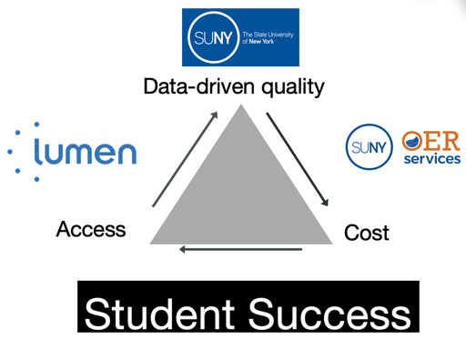

Open Educational Resources
Improve access to learning materials
Reduce cost
Improve Student Success
Notes:
Together we are intensely focused on:
Ensuring data-driven, high-quality OER is available to SUNY students on day one
That the resources are offered at an affordable cost (in SUNY’s case…free)
But, the most important goal is to improve student success

Slide 7






OER in SUNY 2017 - 2019
59 campuses participating in OER initiative
155,000+ students taking
one or more of 4,600 OER courses
$16 million avoided in course material costs
Curated Catalog of OER oer.suny.edu
1000+ faculty using OER
Educational impact still being measured, but early signs are good!
SOURCE: © Nikolaev, © Photoworld, © Meanev, © Idrutu, © Palto | Dreamstime Stock Photos & Stock Free Images
Notes:
Funds provided by NYS budget and through our partnership with Lumen, over the past two years:
59 campuses offering OER
Over 155,000 SUNY students enrolled in at least one OER course
We have a growing curated catalog of OER, built in collaboration with our partner Lumen Learning and now OLI.
Over 1,000 faculty using OER and growing
About $16 million in textbook savings for students
Anecdotal evidence shows students tend to improve; our research shows OER not magical. Success tied to faculty redesign of courses

Slide 8
Building Momentum: High Quality Micro-Credentials
50 campuses attended March 22nd workshop
Growing recognition of SUNY Micro-Credential definition:
  Verify assessed, skills and competencies
  Adopted via faculty governance
  Endorsed by the institution
  Strategically implemented, portable, and stackable
Current micro-credentials serve existing students; provide pathways for adult learners to degrees; and form new business partnerships, e.g.,
UAS Programming
Food Literacy
Accounting Computer Skills
Addressing Public Health Disparities
www.suny.edu/microcredentials
Notes:
Addressing Public Health Disparities - Bundling one graduate-level course with a local, national, and an international outreach experience. The UB micro-credential targets students in the health professions who will serve as part of multi-disciplinary teams that provide screenings, education, and direct patient care to those that need it most.
Food literacy is a Stony Brook development micro-credential for a local non-profit whose employees work with individuals with disabilities. The micro-credential trains employees to recognize food insecurity and advise on healthy shopping and eating habits.
UAS (Unmanned Arial Systems) Programming: One of a series of five drone related micro-credentials funded by the National Science Foundation at Mohawk Valley Community College that stack to their Information Science Degree
Accounting Computer Skills: Developed in response to requests from local small business, this Ulster Community College micro-credential focuses on excel and quickbooks; it stacks to their Business degree.

Slide 9
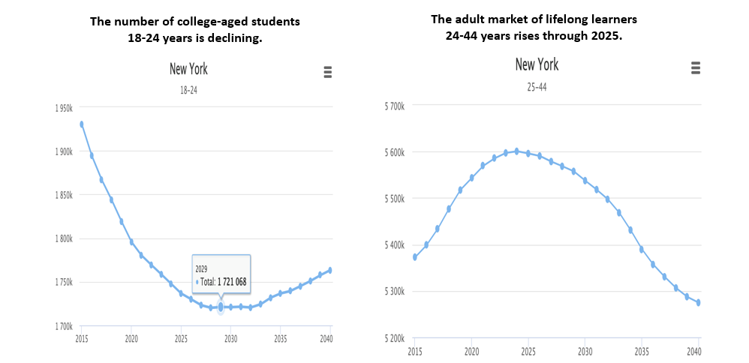
Changing Population of New York State

Slide 10
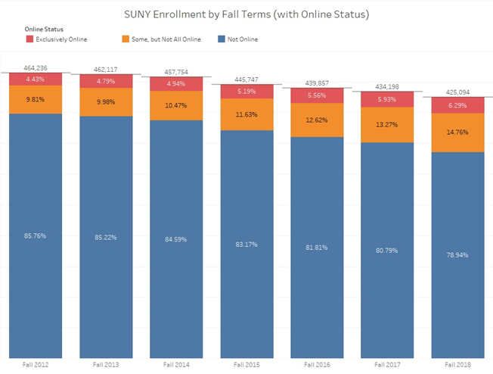

Slide 11
SUNY Online Focus
Increase the number of 100% online learners;
Target post-traditional students and out of state and international;
Target programs that can scale to 1,000+ students in 3 years
Work with partners to respond efficiently as a system to market opportunities
Target courses/programs that fill in the gaps of existing SUNY-wide online offering
Bring back the 40,000 NY residents who are going to non-NY online institutions

Slide 12
Strategic Program Development
Enhanced Marketing & Recruitment
Partnerships
Retention Student & Faculty Supports
Opportunities for Reaching Scale
More fully online programs in high demand areas
Pathways from associate to advanced degrees
Micro-credentials stackable to degrees
New investment
Targeted outreach demand areas
Strategies to capture market share
Corporate partners
NYS Fortune 500
Military partnerships
Employee training
International markets
Cross-campus programming
Cross-campus support with on-demand courses
Instructional design support for faculty
Student supports and access to wraparound services

Slide 13
[Beta] Pilot Group
Area | Associate | Bachelor | Masters
Security | Cyber: Herkimer / FLCC Emerg Mgmt: TBA | Canton (Cybersecurity) Albany (Informatics) Empire (Emerg Mgmt) | Albany (Informatics) Albany (Adv Cert EP/HS)
Accounting | Monroe CC | Plattsburgh / Oswego / Empire | Oswego / Empire
Psychology | Monroe CC | Empire | TBA
Healthcare Management | FLCC | Canton / Alfred State | Oswego / Empire
Data Science | Monroe (Math); Herkimer (Criminal Justice) | Albany (Informatics) Canton (Crime Analysis) | Albany (Informatics)
Engineering | Monroe (Math); | TBA | Buffalo (Indus Engr)
SUNY Online will also support: advertising and promotion for all 35 online nursing programs and 92 AS programs in business;
provide support for campuses for beta testing of up to 1,500 students in technology enabled discussion board monitoring; work with NYSED
and nursing programs to gain approval of contemporary pedagogical approaches to training, e.g., simulation.

Slide 14
Phased Approach Implementation
Multiple phases: pilot; launch Fall 2020; launch each fall (or semester if possible) thereafter
Pilot phase will allow for:
  System development, integration and testing;
  Identification of needed academic and administrative support systems and tools
  Student, faculty, user, feedback and problem solving
Lessons learned will be integrated into the launch phase for Fall 2020
Program identification, assessment, selection and development for launch in Fall 2020 will take place in Summer / Fall 2019

Slide 15
Pilot Goals (what do we hope to learn?)
What does it take to enroll 2000 students?
How can we track inquiries through to enrollment to assess effectiveness of promotion strategies?
Test of SUNY Online Support Staff model – what worked well, what did not?
Test of centrally provided ID support model – what worked well, what did not?
What are good instructional models for delivery of large enrollment online courses?
Test of initial SUNY Online IT Stack - How well did the SIS/Early Alert/Degree Works integration work? How well did Blackboard Ultra work?
Do we need to make any revisions to the Open SUNY+ signature elements as we scale?
How to structure the System Admin/Campus Revenue Share model as we scale?
What administrative structure is needed on the campus to enable programs to scale?
What does investment in promotion of the field result in? What worked well? What did not?
How to integrate AI technology into student support model to enable higher quality of learning?
What marketing campaigns work best for different programs?
How to handle cross-campus business operations, e.g., hiring of graduate student Tas?

Slide 16
Data Initiative: moving towards predictive data analytics
Renewed emphasis on data informed decision making
Going beyond data warehousing to establish predictive data analytics capability for System Admin and campuses
Identifying tools for academic planning and budgeting
Looking critically at academic IT support needs and existing infrastructure

Slide 17
Data Initiative: the challenge
Online catalog of programs. Ranku at System, multiple products at campuses
Contact Relationship Management (CRM). Multiple instances of Slate; Recruit, Salesforce
SIS. All multiple instances: Banner, Colleague, PeopleSoft, Workday, Datatel
LMS. All multiple instances: Blackboard, Moodle, Canvas
Early Alerts/Student Retention. All multiple Instances. Starfish, Advise, EAB Student Success
Course Audit. Multiple instances: DegreeWorks
Transfer Audit. Transfer Finder

Slide 18
The State University of New York
Q & A
www.suny.edu
Presented by John Lenny

Slide 19
Pilot Selection Criteria for Fall 2019
Previously approved (campus and System) online programs only
NYSED approved for distance education delivery
Open SUNY+ Signature Elements developed w/Provost Open SUNY Advisory Committee in 2015
Willingness to support integration efforts to System IT stack: Banner, Ranku, Slate, Blackboard, Starfish, Degree Works, Transfer Finder
Campus readiness to test new system integration
Program Clusters – multiple pathway capability
Potential to scale program enrollments to 1,000 within 3 years

Slide 20
Program Identification-- Fall 2020
Faculty workshops to be scheduled for themes where webinars identified possible collaborations for new pathways, new program development, opportunities for core course development
RFP(s) to be issued to seek proposals for stand alone courses for undergraduate electives, general education options, and core courses identified by thematic webinars, concentration areas
Open RFP(s) for program offerings to “fill the gaps” in SUNY-wide offerings (not intended to compete with existing programs)
Evaluation of department of labor statistics w/r/t market needs
Campus IT infrastructure readiness

Slide 21
Timeline for Fall ‘19 Pilot Programs
Programs/campuses confirmed by 5/17
Campus Kick-off meetings completed by 5/24
Updated projected schedule of courses and faculty provided by 5/31
Faculty teaching in Fall courses identified by 6/10
SUNY Express Portal (Phase I - recruitment) launched by 6/1
ID template for SUNY Online LMS finalized by 6/14
Applications open for pilot programs on 6/1
Applications close for pilot programs on 8/1 (where appropriate)
Courses ready to go in SUNY Online LMS by 8/15
Admissions decisions made by 8/15 (or based on campus requirements)

Slide 22
Online Education: Next Steps
    Expand marketing and recruitment campaign
    Budget development, financial modeling, budget advocacy
    Infrastructure development (IT system identification and integration)
    Program strategy, identification, development, and governance
    Develop system-wide communication / marketing strategies
    Establish mechanisms, e.g., focus groups, etc., for ongoing stakeholder engagement including faculty/shared governance, e.g, FCCC, UFS, SA executive committees
    Theme-based workshops to further develop ideas for Fall 2020 and beyond
    Open and directed RFPs for Fall 2020 GenEd, electives, programs outside theme areas, and concentration stacks for anchor programs

