Slide 1

Working Together to Achieve
a Higher Degree of Success
Paul Marthers, Associate Vice Chancellor/Vice Provost
for Enrollment Management and Student Success
2015 School Counselor Forum
Fashion Institute of Technology • May 8, 2015

Slide 2

Educating more people
Educating them better
Best bet a
society can make
A + C = S
ACCESS
COMPLETION
SUCCESS

Slide 3


of ACCESS
empowers the citizens of New York State

Slide 4



Early Advisement

Slide 5

College Advisors in High School

Slide 6
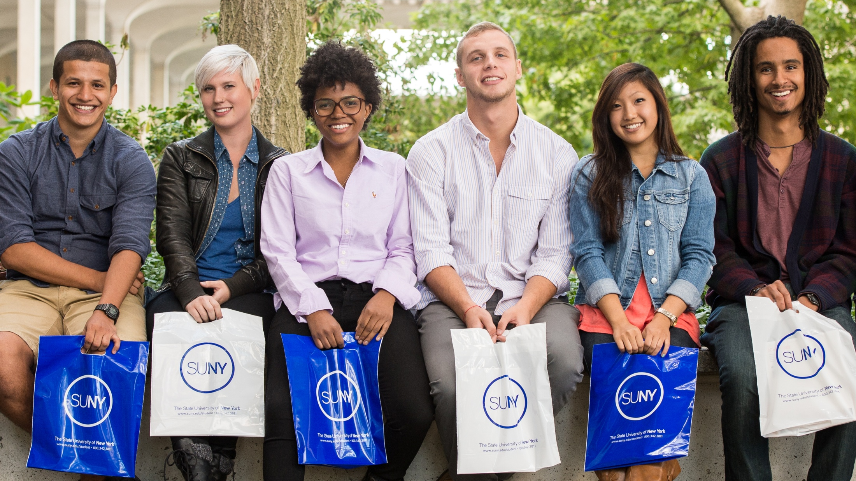
Early Engagement

Slide 7

College Readiness MOOC

Slide 8

High School Electronic Transcripts

Slide 9

Educational Opportunity Program

Slide 10
30,000 people apply for
2,500 seats

Slide 11
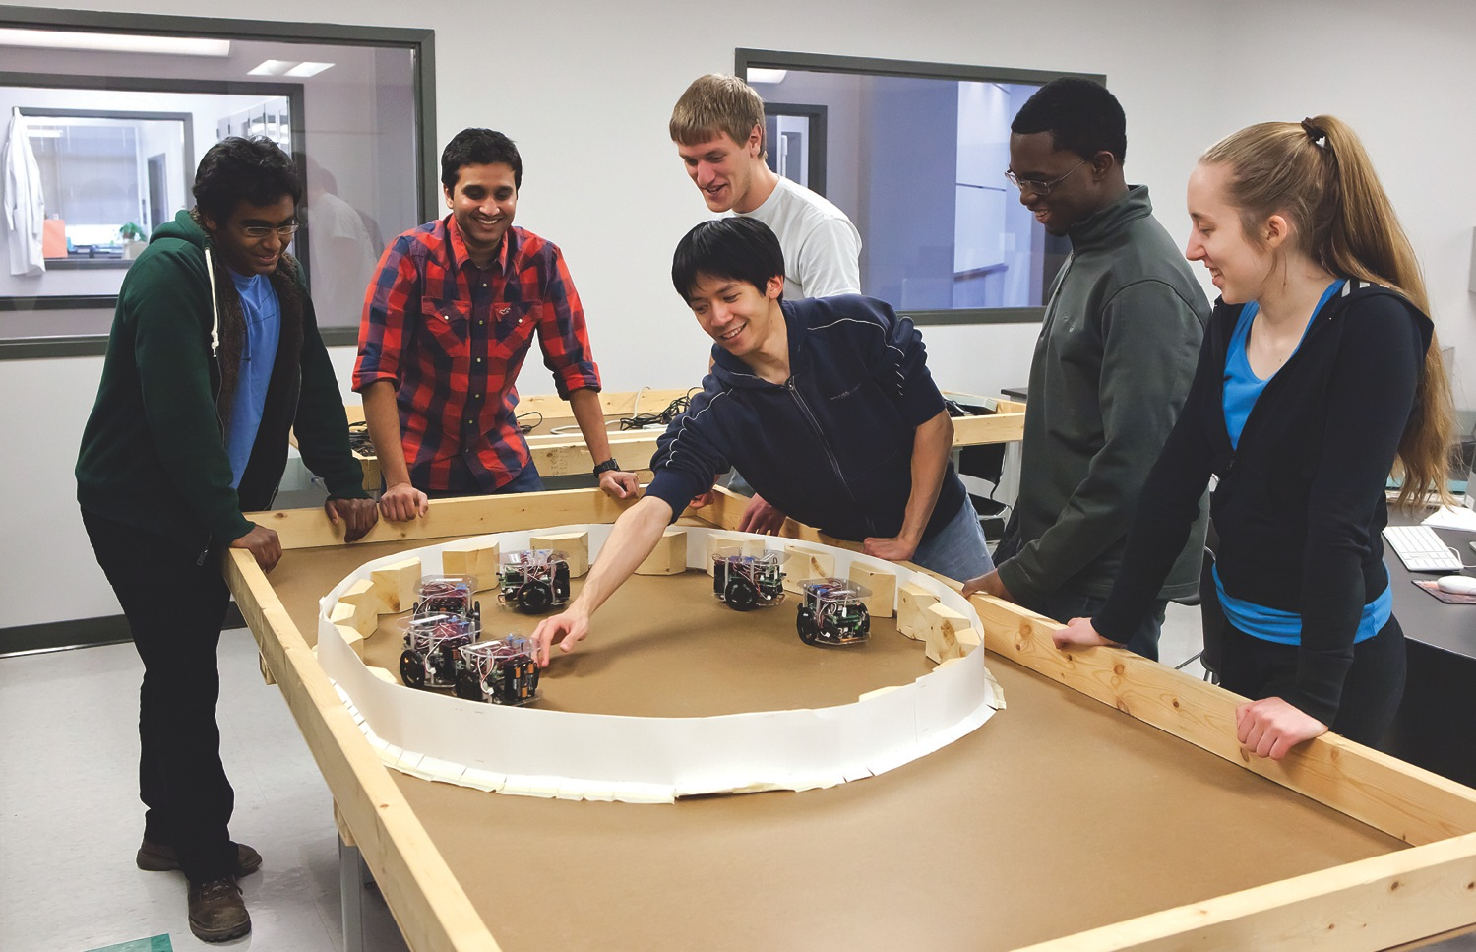
Diversity

Slide 12
15.8%
of New York’s High School graduates are African American
Compared to 11.4% of our freshman system-wide
14.7%
of New York’s High School graduates are Hispanic
Compared to 9.3% of our freshman system-wide

Slide 13

Chief Diversity Officers
Notes:
.

Slide 14

ACCESS
Early Advisement
Early Engagement
Diversity

Slide 15
of COMPLETION
ensures a strong workforce in New York State

Slide 16
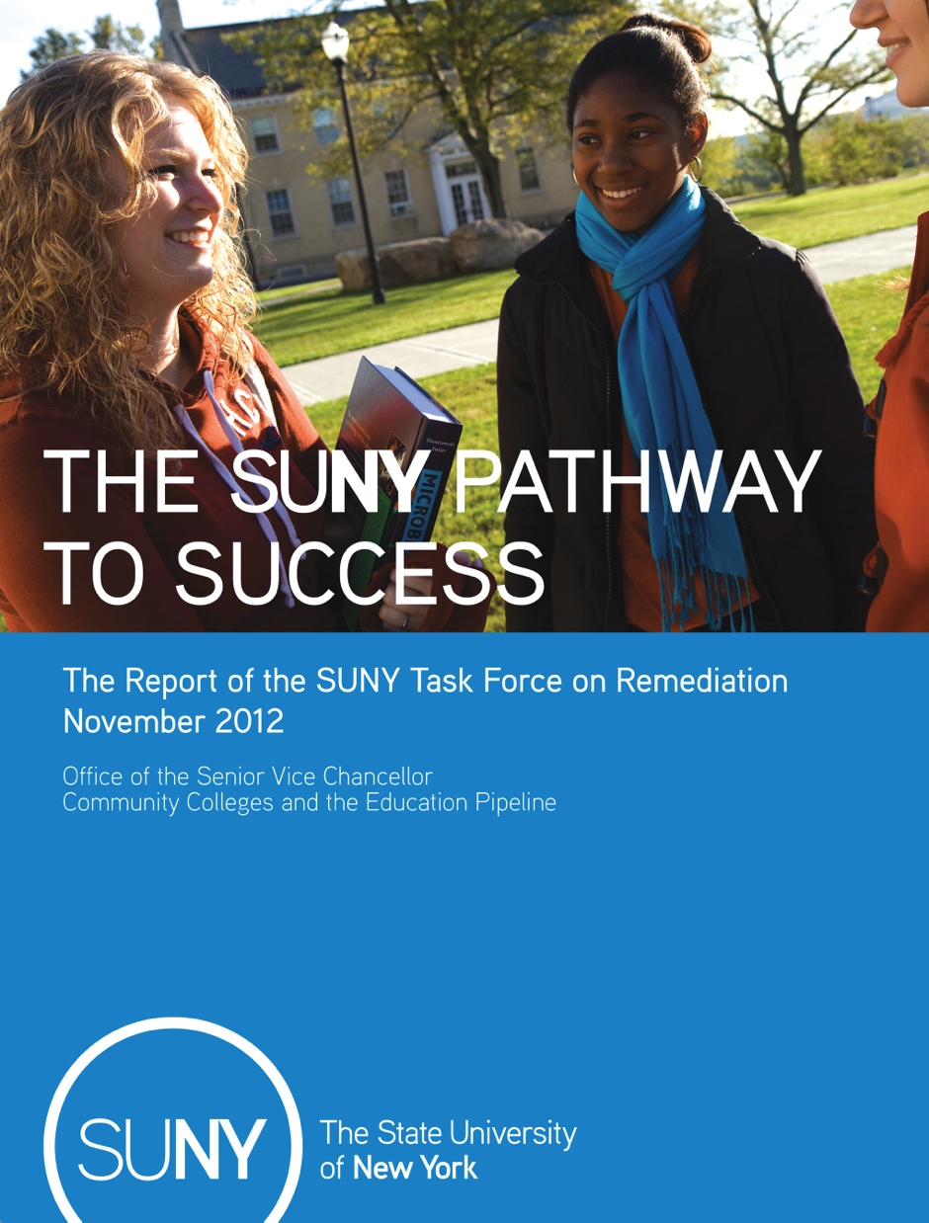
Remediation

Slide 17



Slide 18
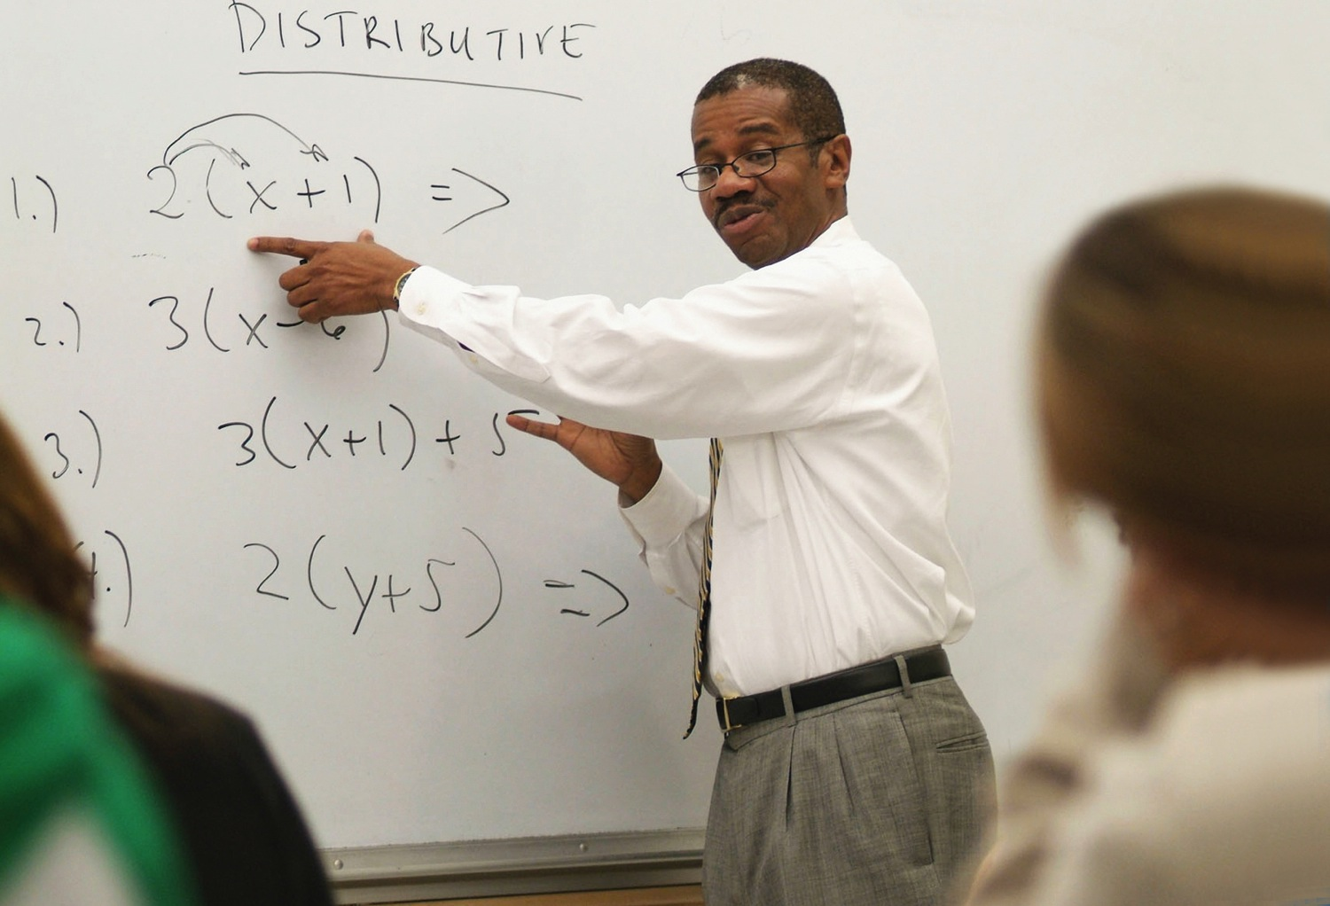
Quantway & Statway

Slide 19

Finish in 4

Slide 20
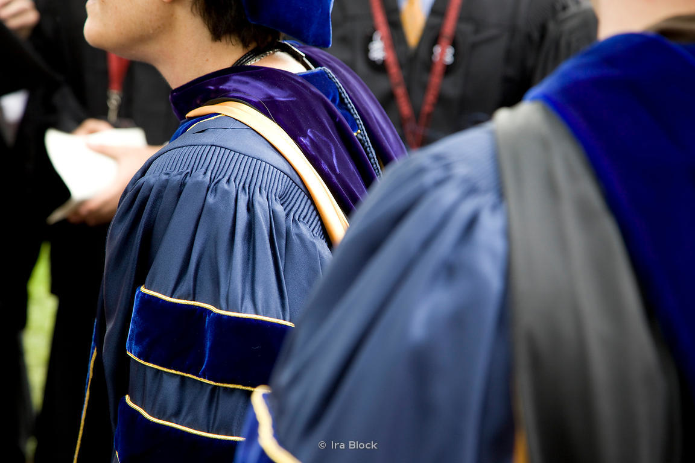
Finish in 4 for Graduate Students

Slide 21




Slide 22



















Open SUNY+ Partner
Programs
19 Campuses
64 Programs
Certificate to Masters

Slide 23
COMPLETION
Remediation
Finish in 4
Open SUNY

Slide 24
of SUCCESS
provides a better quality of life for everyone in New York State

Slide 25

Master Innovators

Slide 26
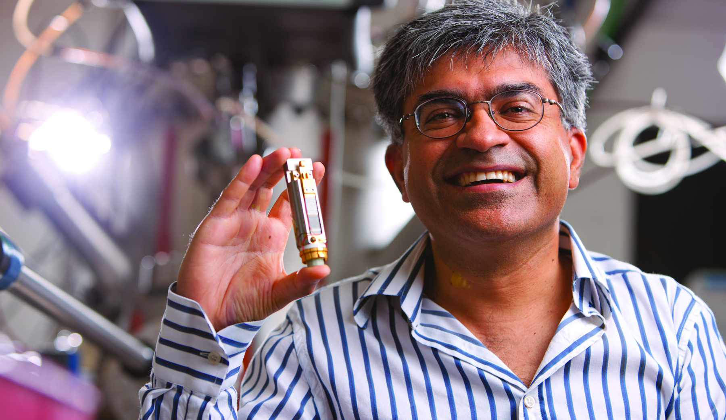
Master Innovators
Notes:
.

Slide 27



Slide 28





Slide 29
SUCCESS
Master Innovators
SUNY Works

Slide 30
A + C = S
ACCESS
COMPLETION
SUCCESS

