Slide 1






A View from Behind the Desk in Admissions

Slide 2

OpInform 2014
Agenda
Technology used in Admissions
Information Flow
  SUNY Application
  Common Application
Information Presentation
  Review
  Evaluation

Slide 3
OpInform 2014
Technology Used in Admissions
Who is the Technology for?
  Student
  School Counselor
  Admissions Office

Slide 4
OpInform 2014
Technology for Students
Social Media
College Search Engines
Virtual Tours
  Interactive Tour
FAQ Engines
iTunes
Messaging
Smart Phones
Virtual College Fairs
College Search Apps
College Application

Slide 5
OpInform 2014
Technology for School Counselors
High School Data System
CAO Online
Counselor Connect
Email
Video Chat

Slide 6
OpInform 2014
Technology for the Admissions Officer
Data Systems
  Banner, Peoplesoft, Datatel, etc.
Data Imaging/Pushing
  Banner Extender (BDMS),Onbase
Email Managers
  Right Now Technology, Fire Engine Red, 422 Group,
  Constant Contact, Hobsons
Electronic Transcripts
  SOAR
  STARs

Slide 7
OpInform 2014
Information Flow
SUNY Application
Common Application
Processing Time
  Downloads/Mailing
  Confirmation/Reminders
Student Communication/ Counselor Communication

Slide 8
OpInform 2014
Information Presentation
View of Materials Received by a College
File Review
Document Imaging
  Used by other Offices on Campus
Transcript Evaluation
What we are Looking for
Volume

Slide 9

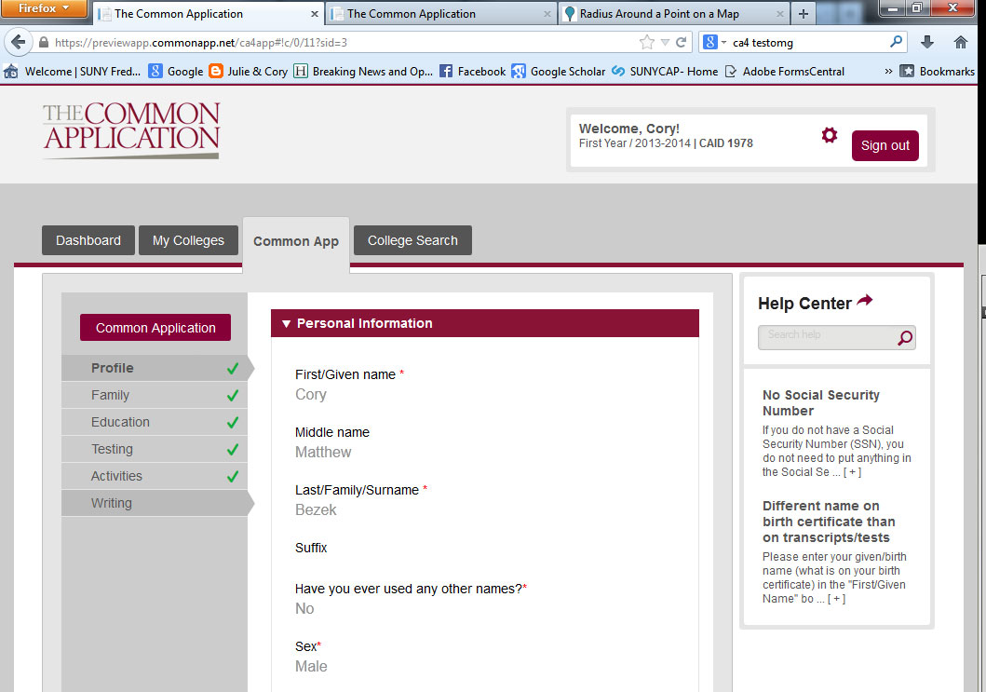
OpInform 2014
Information Presentation

Slide 10
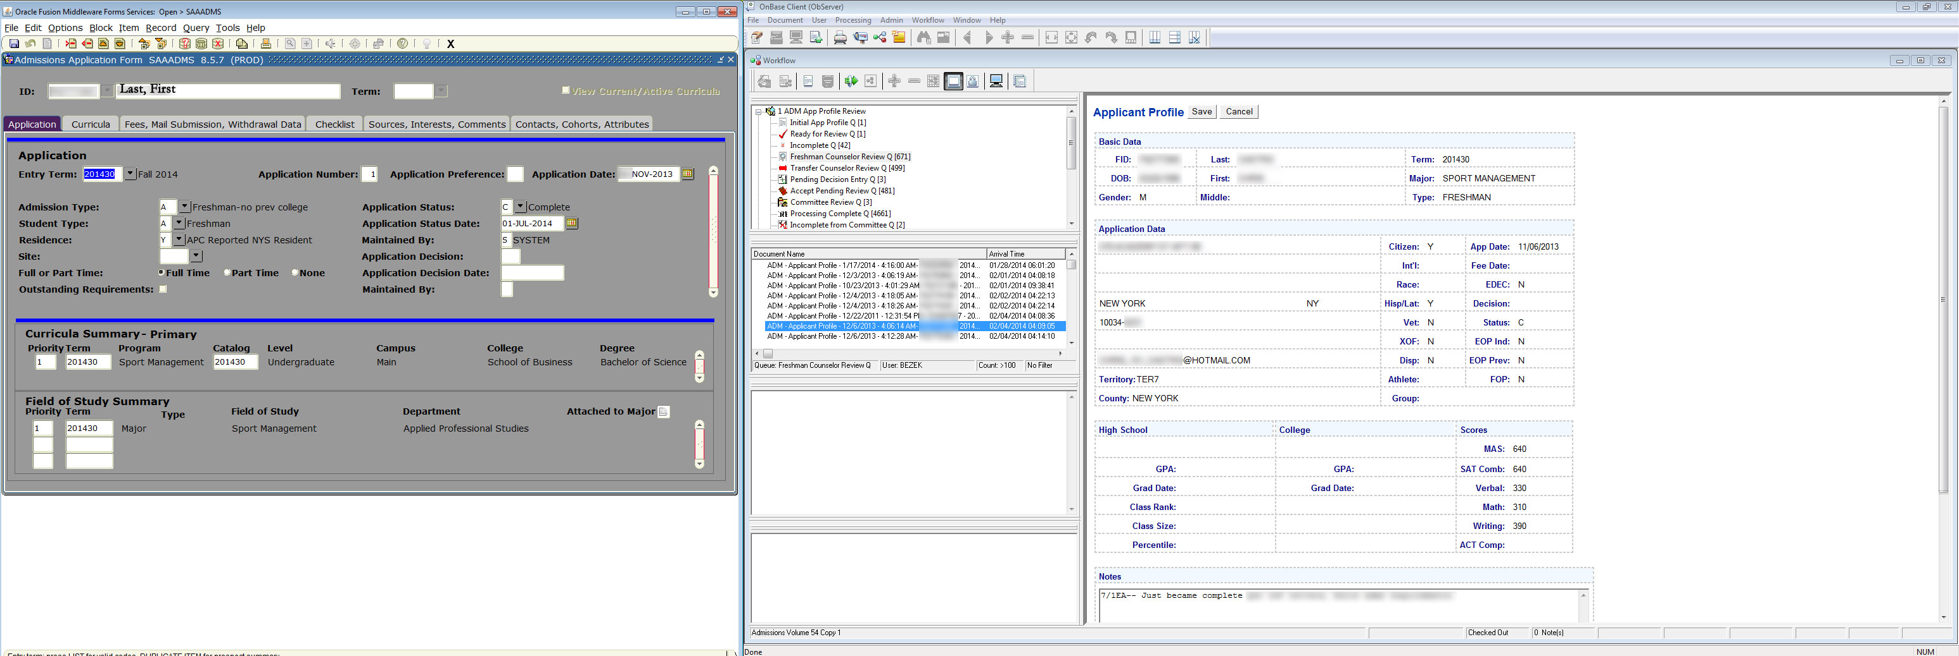
OpInform 2014

Slide 11
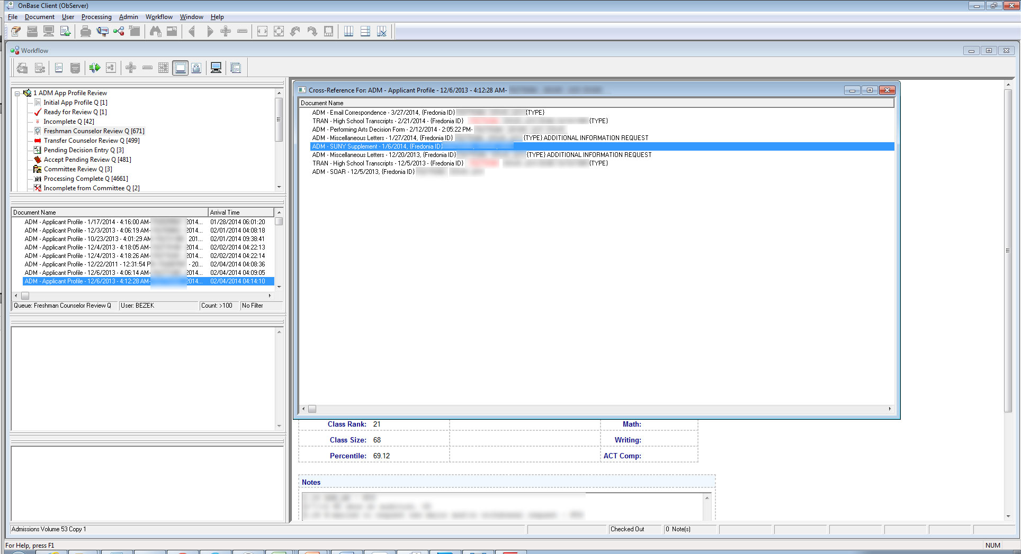
OpInform 2014
Agenda

Slide 12
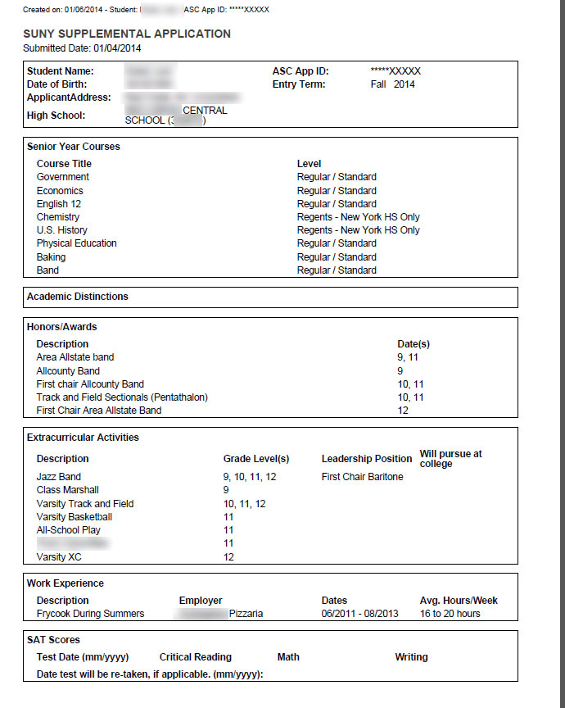
OpInform 2014
Agenda

Slide 13
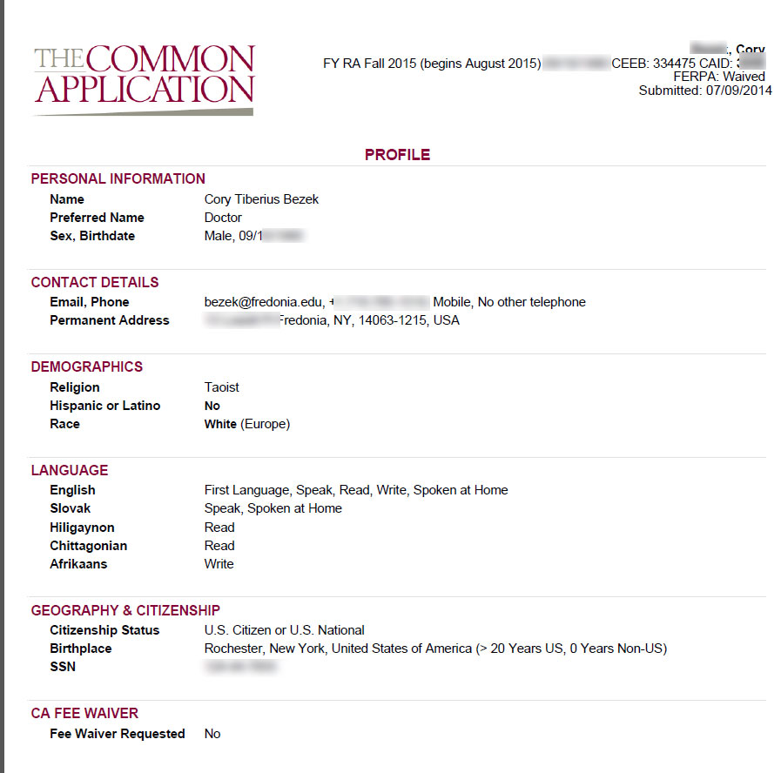
OpInform 2014
Agenda

Slide 14
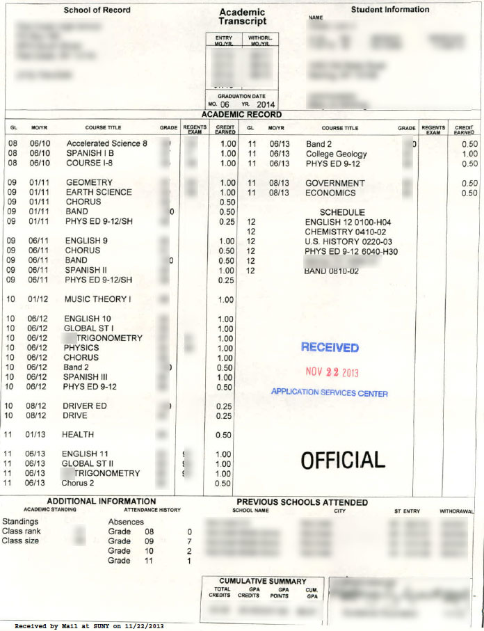
OpInform 2014

Slide 15
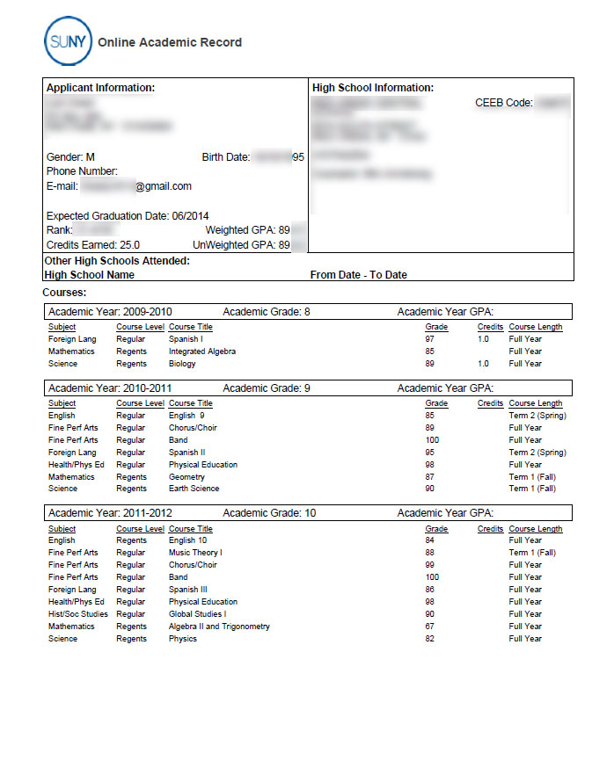
OpInform 2014
Agenda

Slide 16
OpInform 2014
Evaluation
What are we Looking for?
Academic:
Strength of Schedule
Coursework
Sequence
Subjects
Academic Performance (GPA and Class Rank)
Test Scores

Slide 17
OpInform 2014
Evaluation
What are we Looking for?
Non-Academic:
Character
Work Ethic
Involvement
‘Fit’
Demonstrated Interest
Ability to Benefit
A Student who will be Successful!

Slide 18
OpInform 2014
Thank You!
Questions and Discussion

