Slide 1
Bigger Problem - Solving: Engineering and Engineering Technology Majors

Slide 2

Engineering
or
Engineering Technology?

Slide 3
University at Albany ● Buffalo State College ● Alfred State ● Adirondack ●Binghamton ● Cortland ● Canton ● Fredonia ● Morrisville ● Genesee ● Environmental Science and Forestry ● Corning ● New Paltz ● Dutchess ● Cobleskill ● Stony Brook ● Farmingdale ● Oneonta ● Mohawk Valley ● University at Buffalo ●
Engineering & Engineering Technology Programs
Maritime ● Tompkins Cortland ● Plattsburgh ● Ulster ● Onondaga ● Erie ● Finger Lakes ● SUNYIT ● Broome ● Hudson Valley ● Jamestown ● Oswego ● Jefferson ● Delhi ●
Orange ● Niagara ● Monroe ● Nassau ● Suffolk ●
Rockland ● Westchester ● Sullivan ●
Fulton-Montgomery ● Columbia-Greene ● Schenectady ● NYS College of Ceramics

Slide 4

Difference in Career Paths
Degree Earned
Career
4-year Engineering Program “Engineer”
4-year Engineering Tech Program “Engineering Technologist”
2-year Engineering Tech Program “Engineering Technician”
Accreditation Board for Engineering and Technology (ABET)

Slide 5

New York State and National Employment Prospects

Slide 6
Meet our Campuses

Slide 7
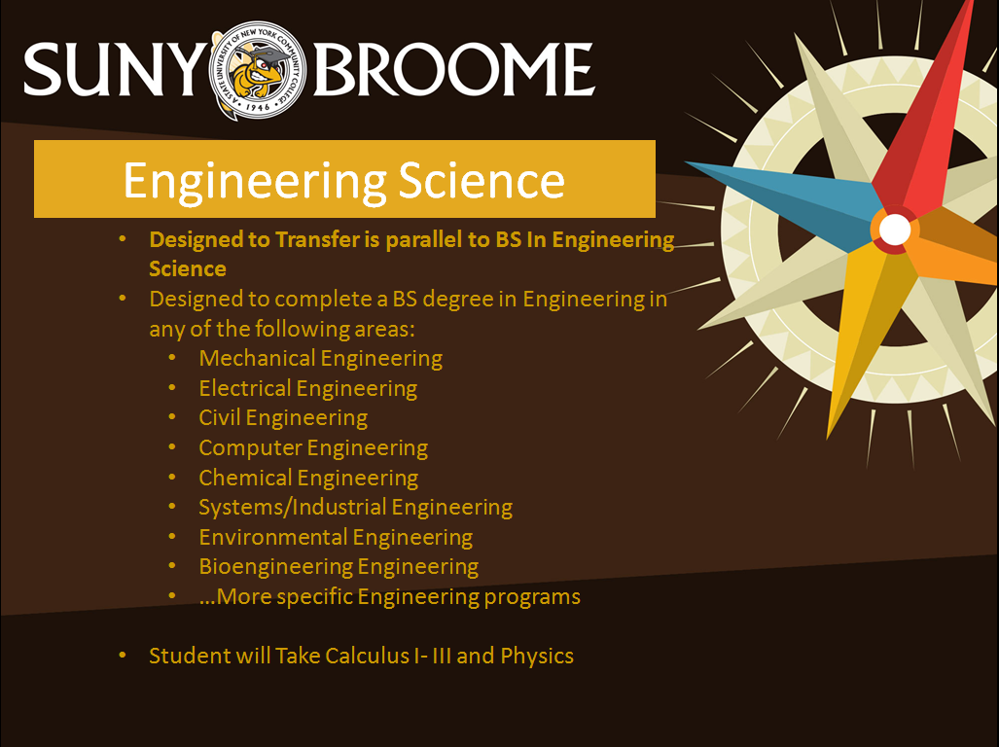

Slide 8


Slide 9
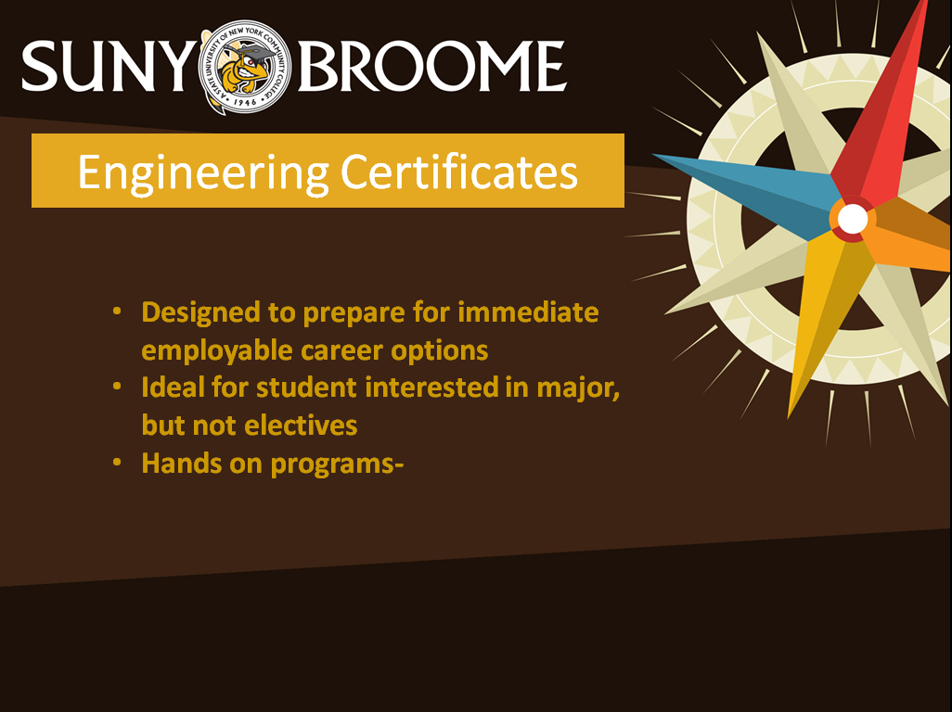

Slide 10
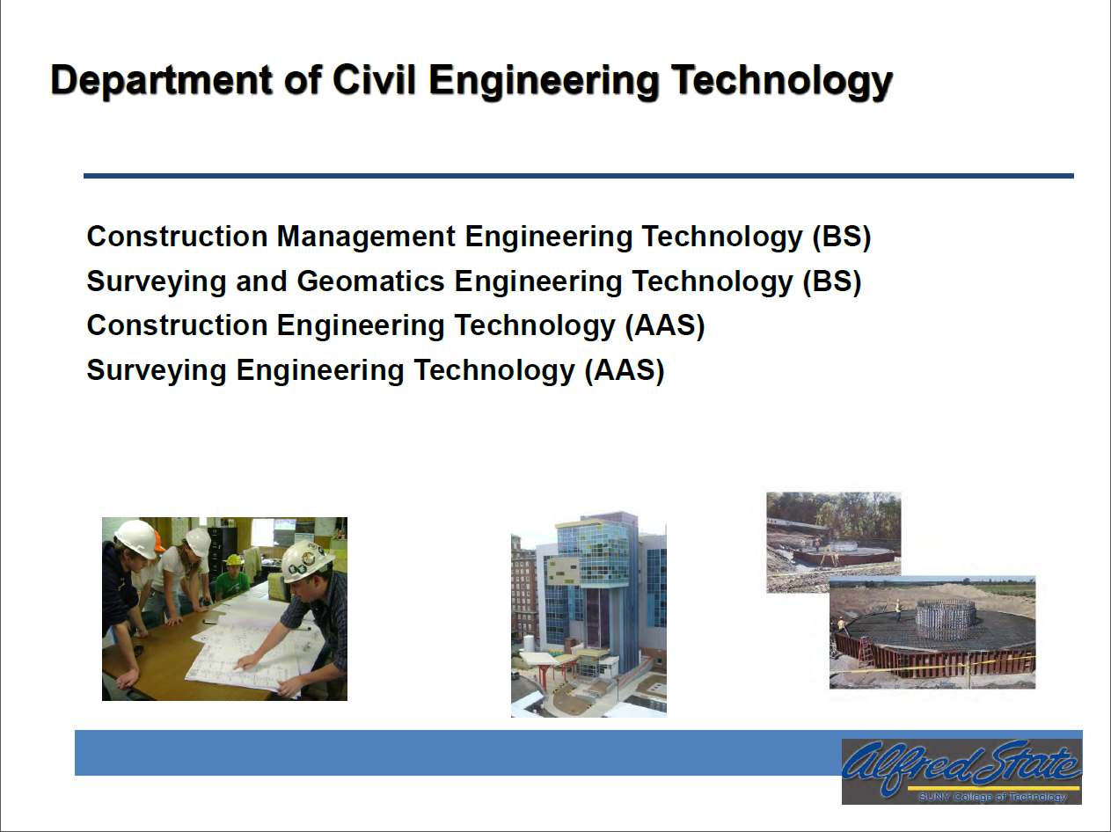

Slide 11
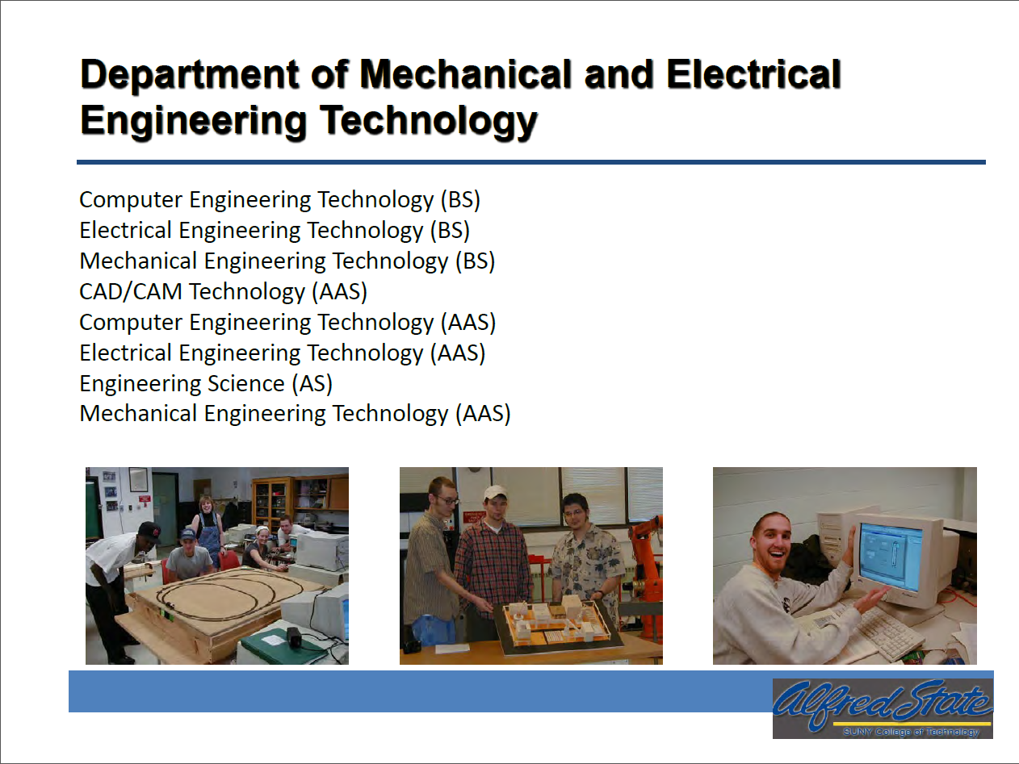

Slide 12

SUNY OSWEGO
Electrical and Computer Engineering (ECE), B.S.
Oswego’s newest major in an engineering field
State-of-the-art facilities and equipment
Teaching is conducted through combined lectures and laboratory experiments in specially designed studio classrooms
Curriculum:
Prepares students for work in high demand concentration areas including robotics, embedded systems, biomedical instrumentation, modern energy systems

Slide 13
SUNY OSWEGO
Software Engineering, B.S.
First Software Engineering program in SUNY
Project-based curriculum
Faculty/student collaborations
Year-long capstone experience
Campus laboratory and instructional facilities support
Curriculum:
Systems-oriented course offers with embedded knowledge areas: design, construction, testing, maintenance, configuration management, engineering management, engineering process, tools, software quality assurance

Slide 14
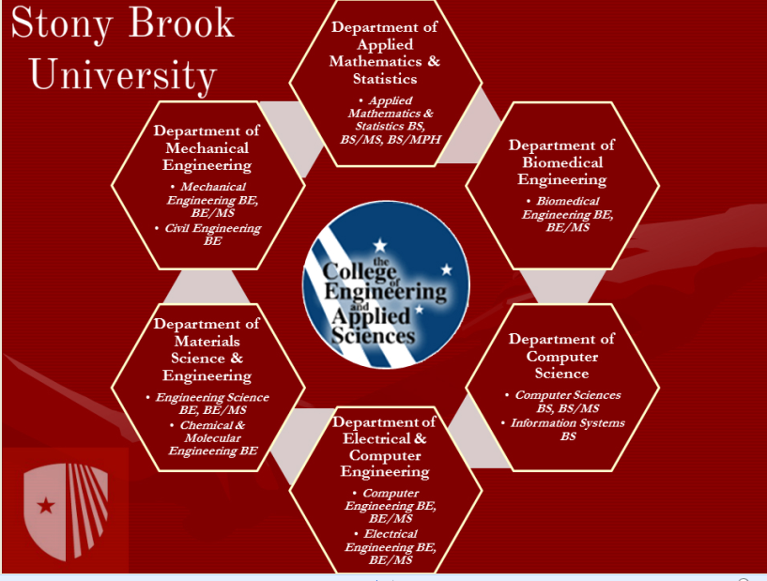

Slide 15
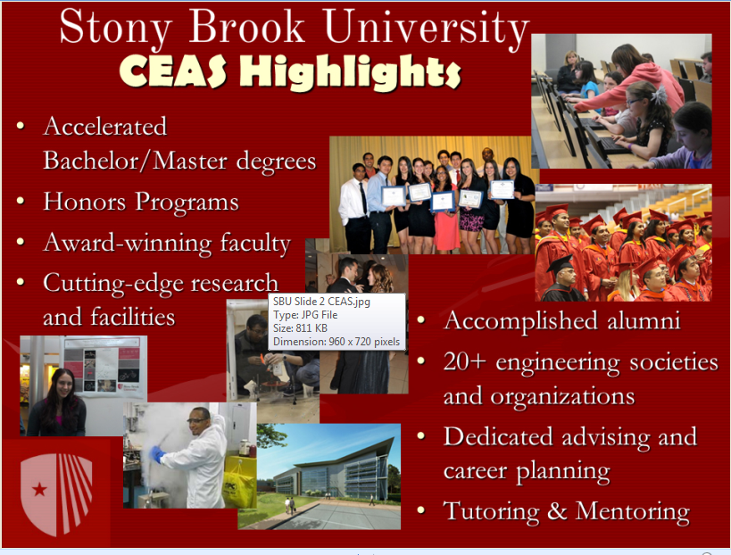

Slide 16
Questions
What three pieces of advice would you give to a high school sophomore/junior interested in engineering?
What related programs of study do you offer for students who change their engineering/engineering technology career path?
What three pieces of advice would you offer to a transfer student interested in engineering/engineering technology?
What engineering-related clubs and activities exist at your campus?

