Slide 1


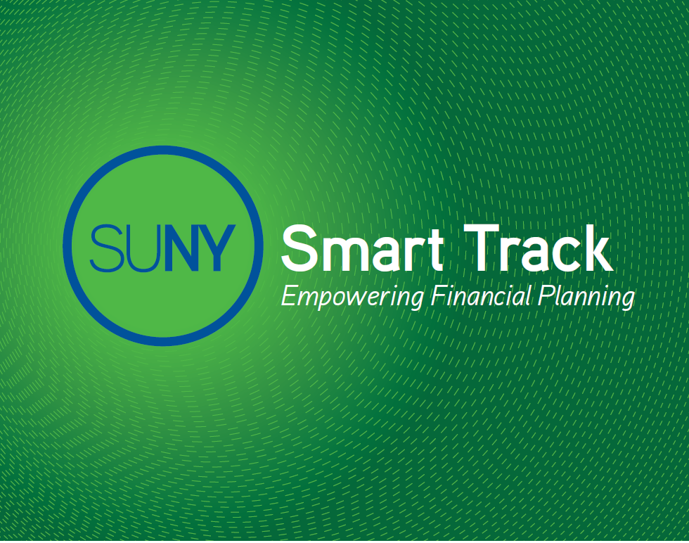
William Cavin
SUNY Smart Track Program Coordinator
SUNY System Administration

Slide 2



What is SUNY
Smart Track?
SUNY Smart Track™
An innovative and transparent system wide approach to promote awareness and understanding regarding college costs, college financing options and responsible student loan borrowing.
www.suny.edu/smarttrack

Slide 3




Smart Track Initiatives
SUNY Approach
SUNY Smart Track Award Letter
SUNY Smart Track NSLDS Email Pilot
SUNY Smart Track Financial Literacy Website

Slide 4
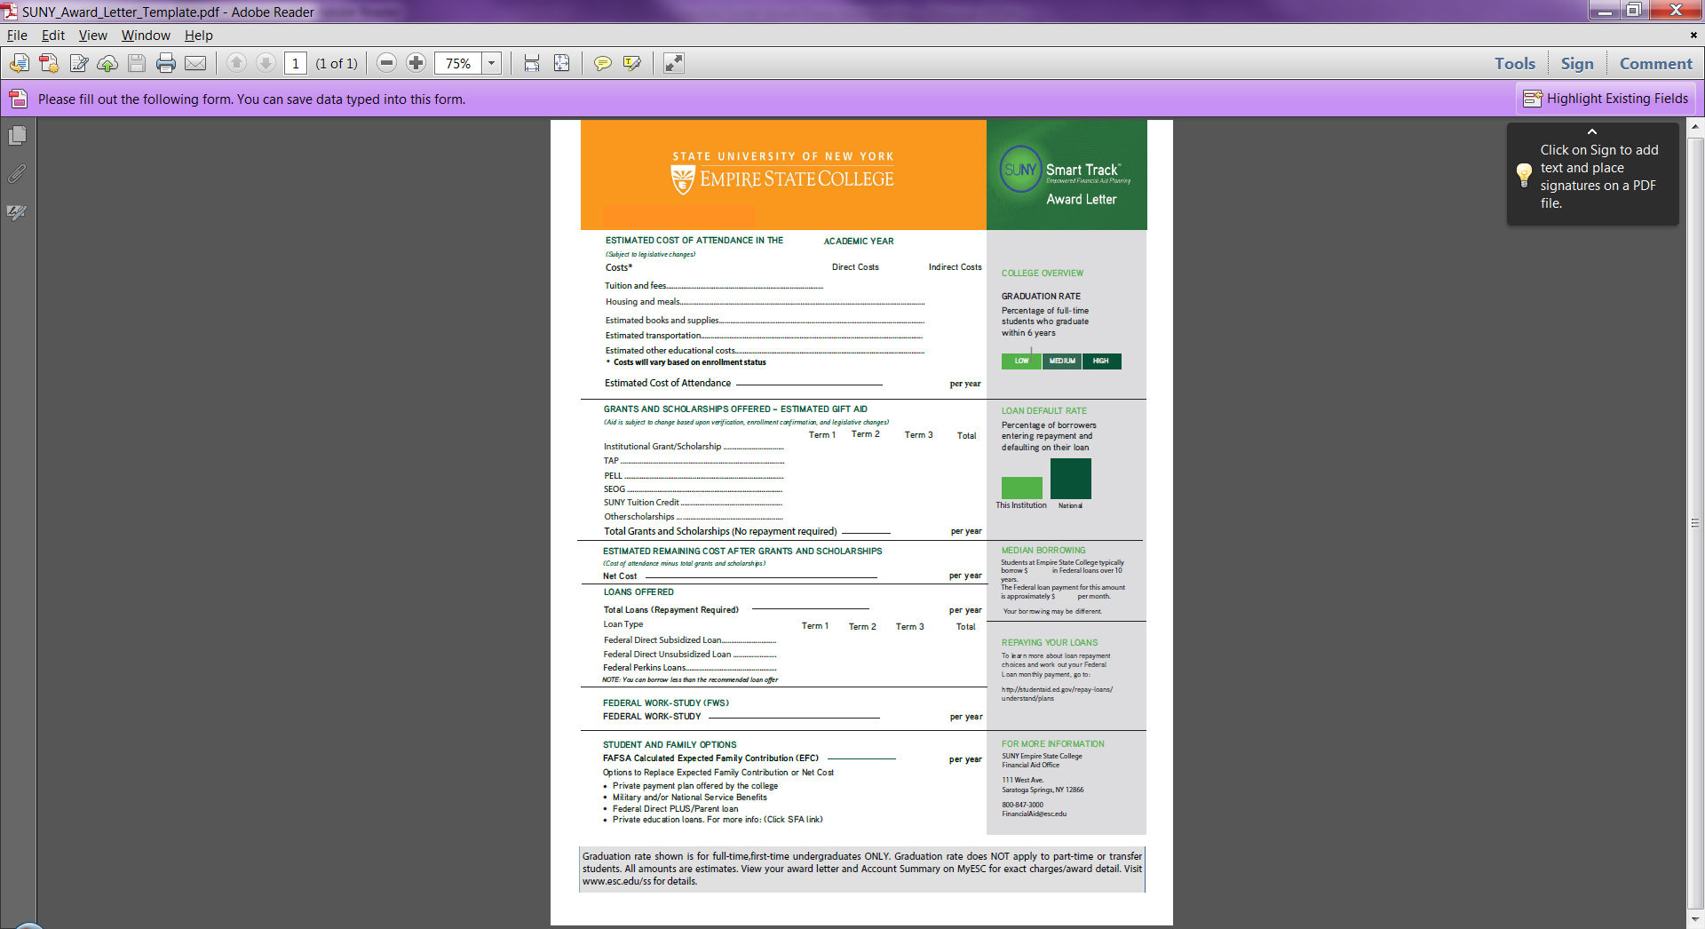
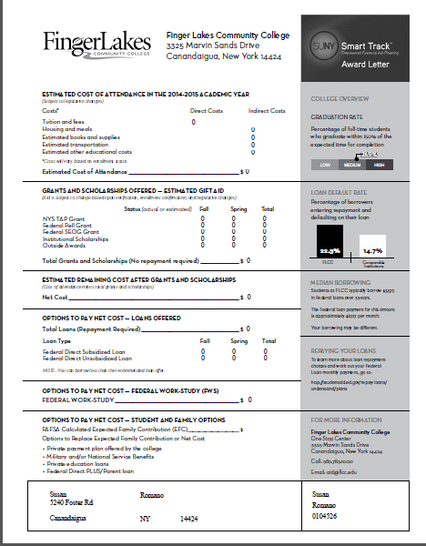
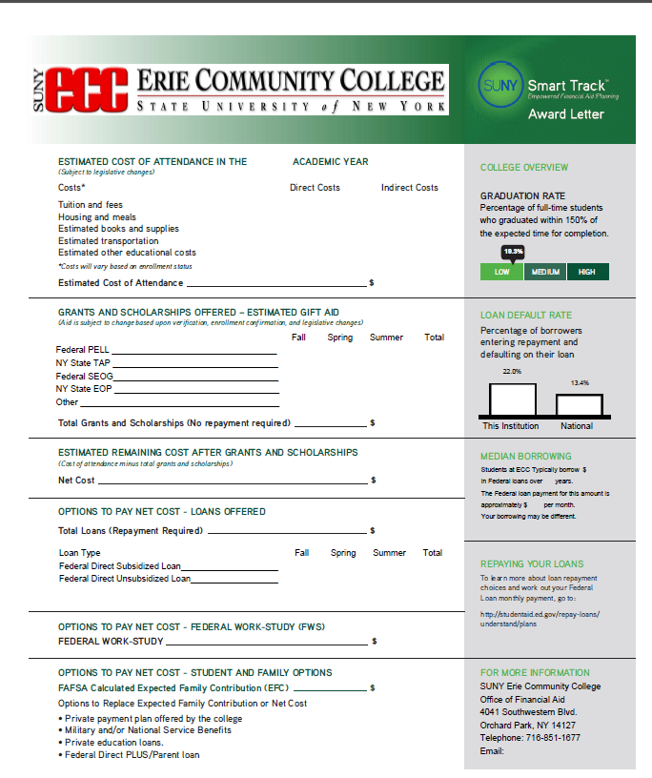
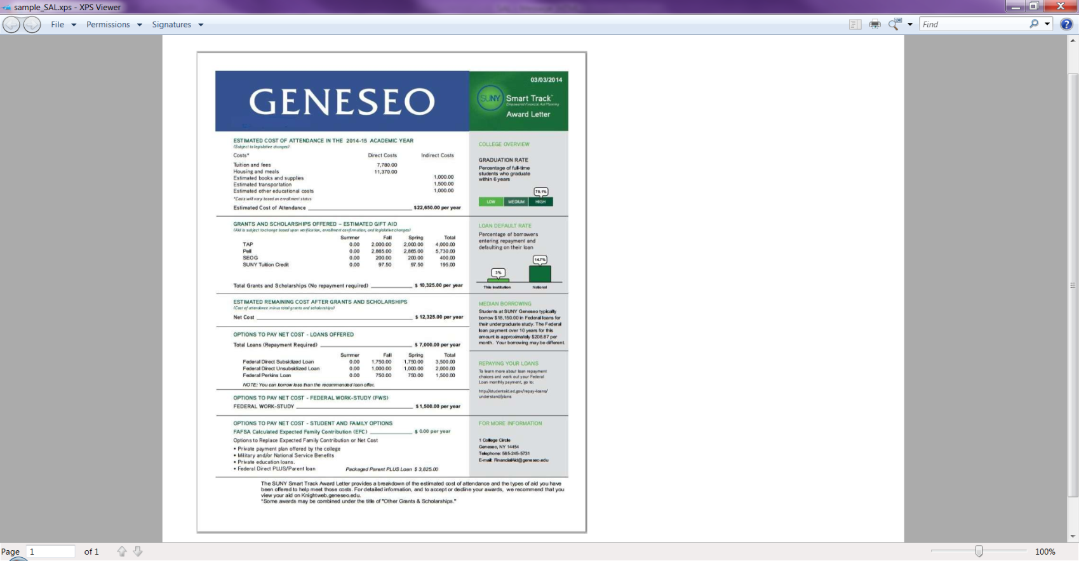

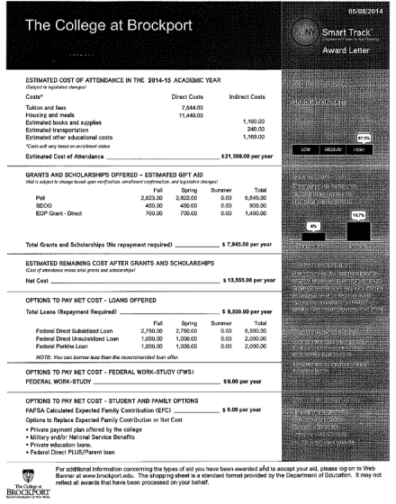
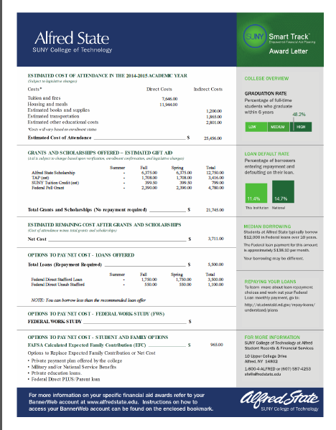
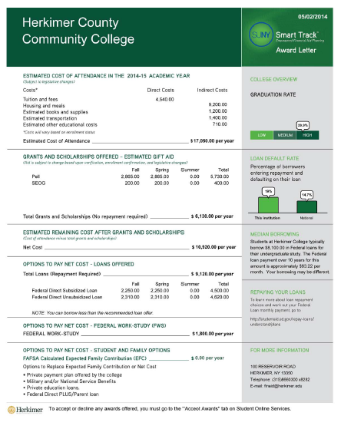
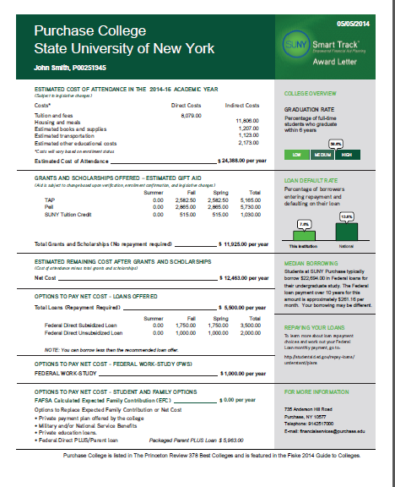
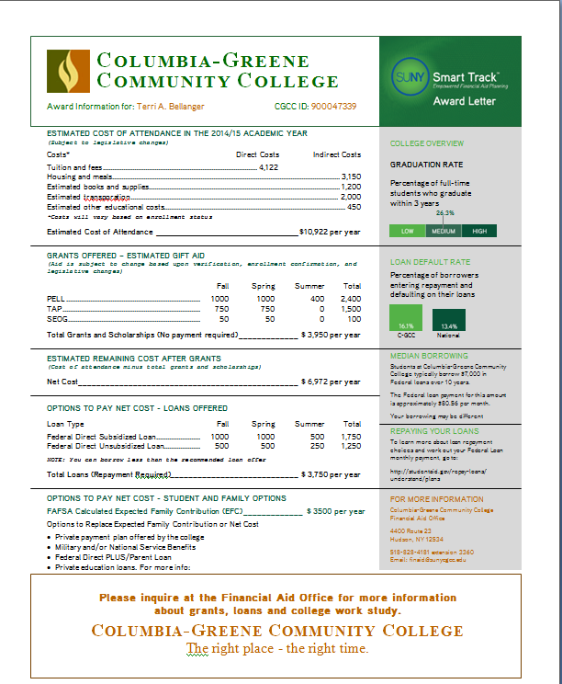
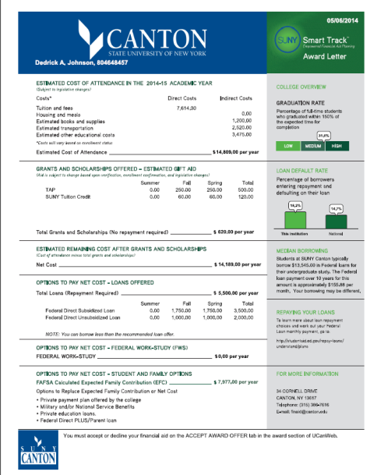
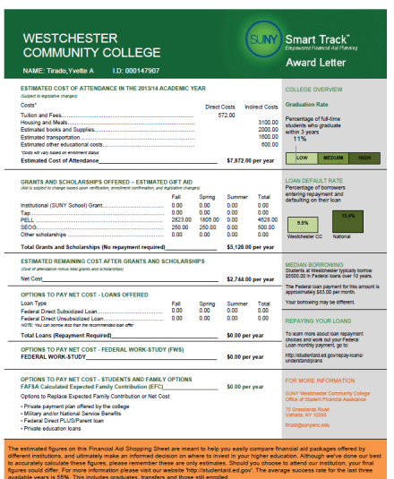
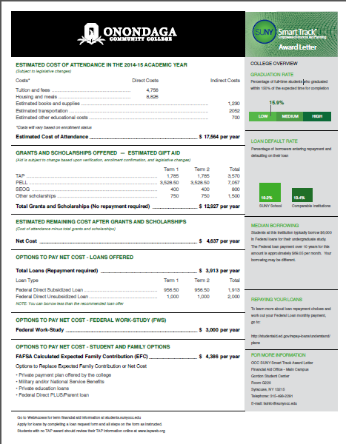
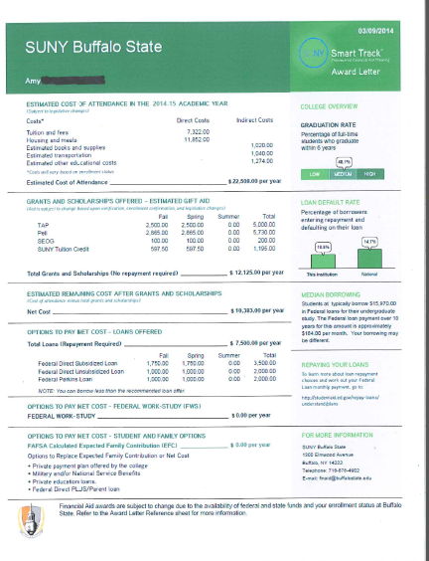
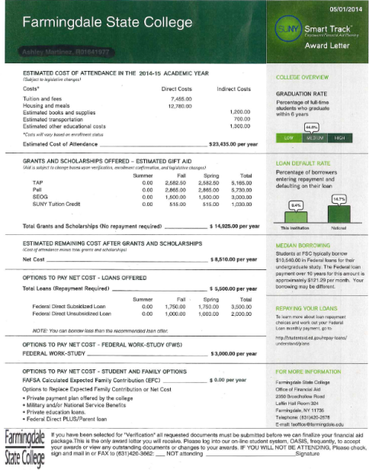
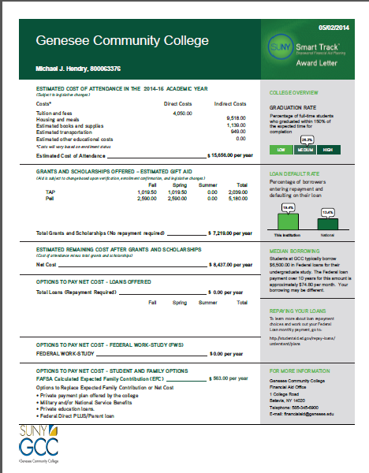
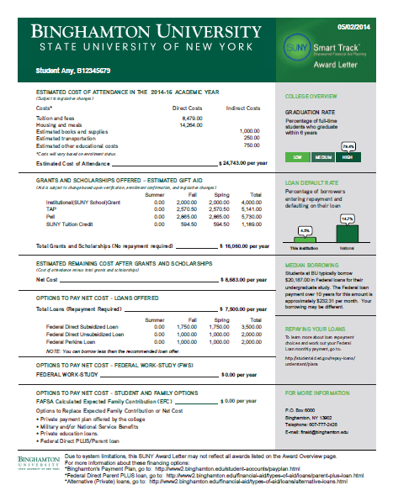
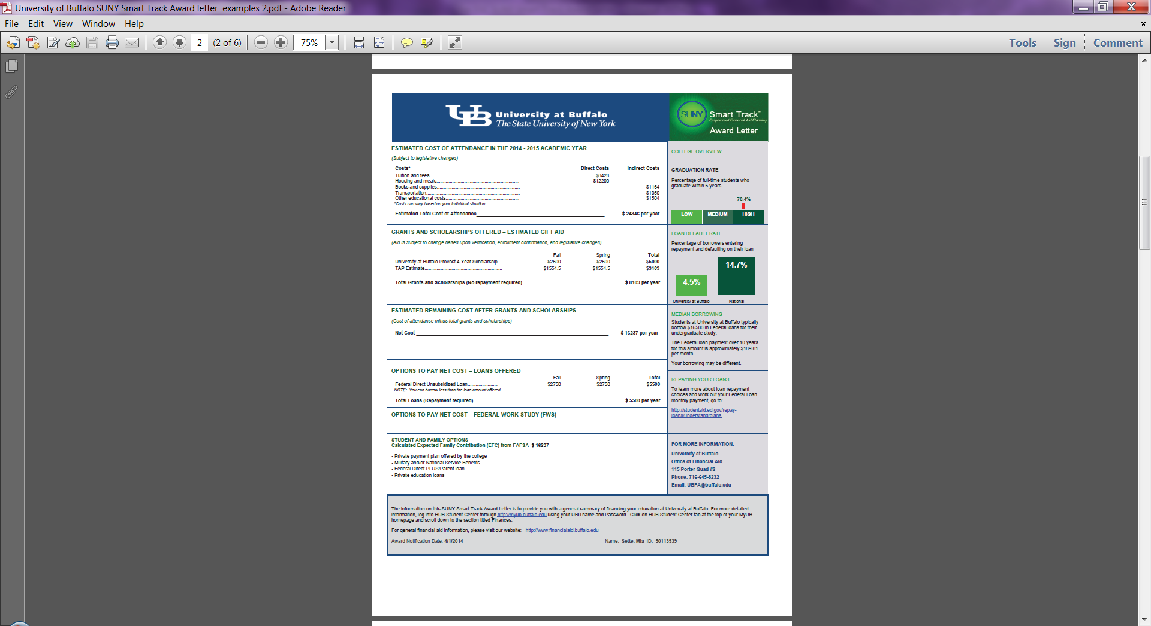
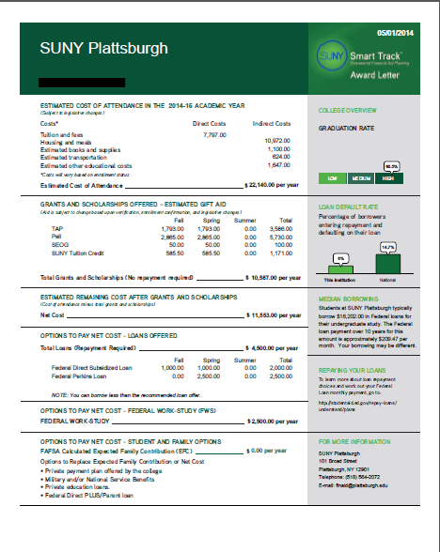
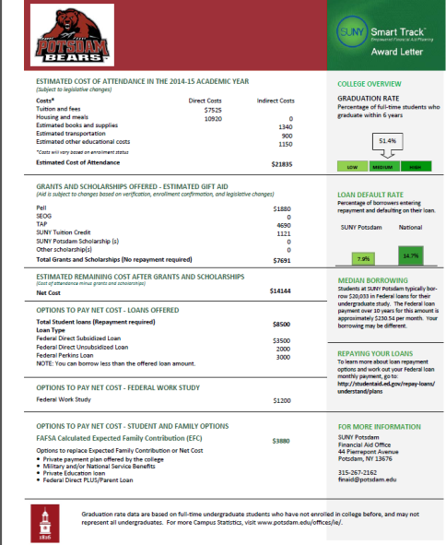
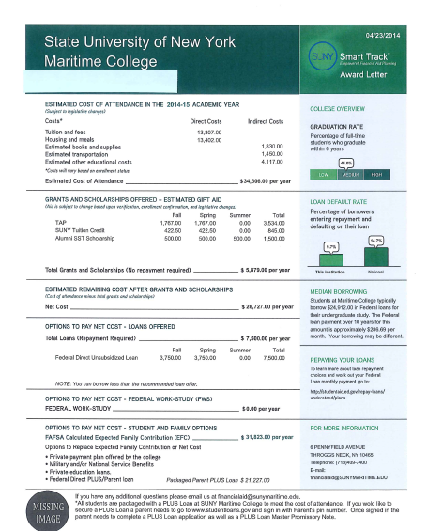
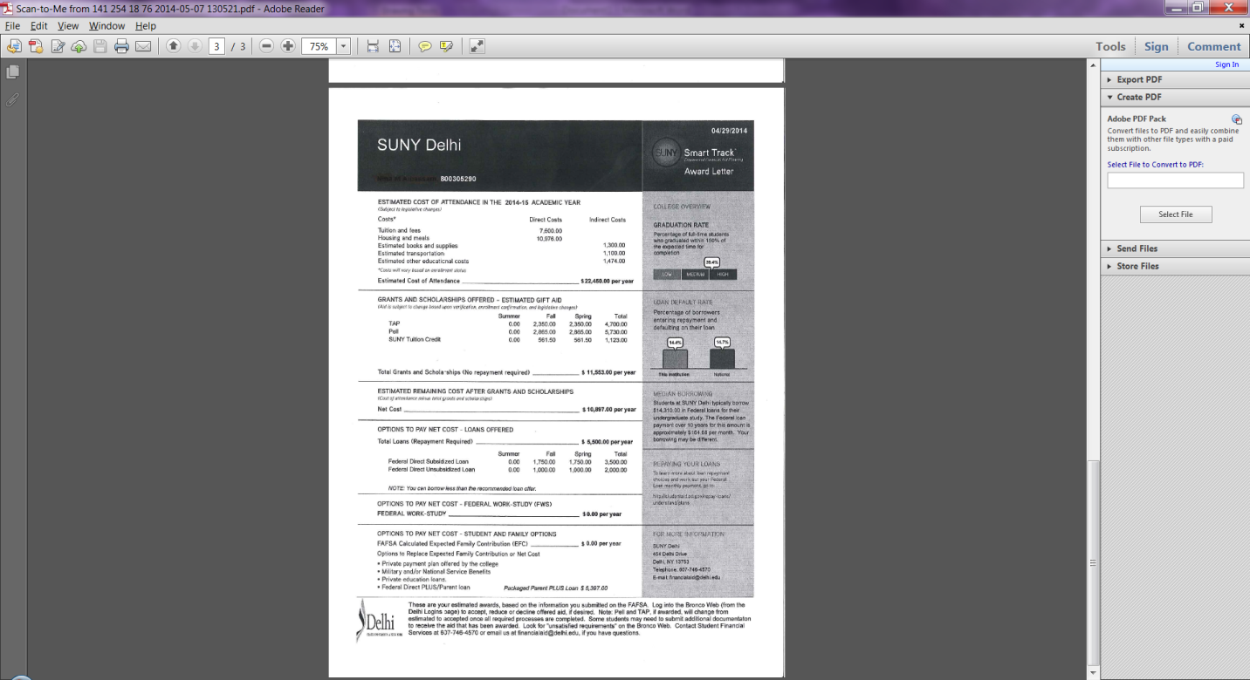
All SUNY University Centers, State Ops and Community Colleges use the SUNY Smart Track Award Letter
Smart Track Award Letter

Slide 5
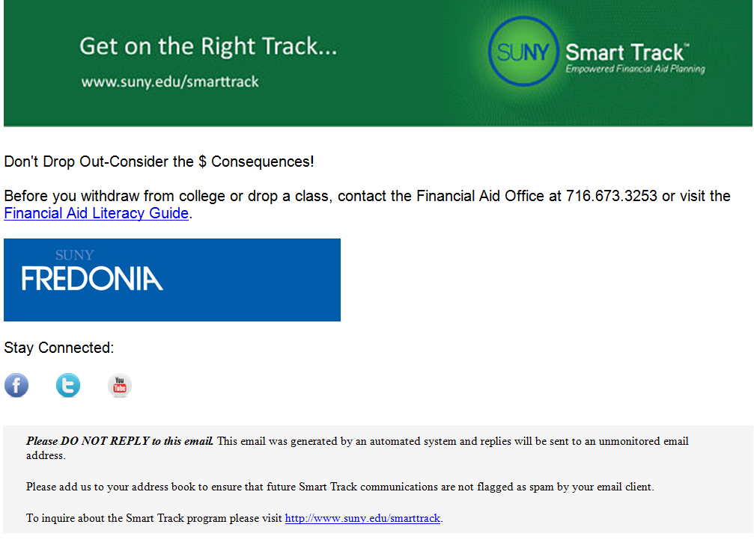
Smart Track NSLDS
Email Pilot
SUNY Approach
Pilot schools:
  SUNY Fredonia
  Niagara CCC
Scheduled emails
during school year
NSLDS First-time
borrowers
Embedded Links
in messages

Slide 6
SUNY Smart Track
Financial Literacy Website

Slide 7

How important is Financial
Literacy For Student/Life Success?
SUNY Knows…
The National Endowment for Financial Education (NEFE) High School Financial Planning Program (HSFPP)
From a survey of 4,000 students from 188 high schools across the United
States who had attended the HSFPP, researchers from the Universities of
Minnesota and Wisconsin found that immediately following training…
… half of the students reported increases in financial knowledge

Slide 8

How important is Financial
Literacy For Student/Life Success?
SUNY Knows…
NEFE High School Financial Planning Program (HSFPP)
Within three months after the training:
  40 percent of the students reported that they had started saving money
  31 percent reported that they had opened a savings account

Slide 9
How important is Financial
Literacy For Student/Life Success?
SUNY Knows…
Gartner and Todd (2005) analyzed a randomized study conducted by the
Saint Paul Foundation’s Credit Card Project that showed that online credit
education led to responsible behavior (prudent credit card usage and spending
patterns) among first-year college students
Once short-run behaviors are changed, they translate into positive results in the
long-run
Moreover, research shows that financial literacy has the most impact on
behaviors that are independent of an individual’s financial situation

Slide 10
How important is Financial
Literacy For Student/Life Success?
SUNY Knows…
SUNY Smart Track Financial Literacy is a value added service provided to all
SUNY students as part of their SUNY experience
Keeping students engaged promotes retention and increases completion rates
Students who complete have financial literacy provided are more likely to
become successful student loan repayers - regardless of the amount borrowed

Slide 11



How important is Financial
Literacy For Student/Life Success?
SUNY Knows…
SUNY is all about STUDENT SUCCESS

Slide 12

Smart Track Financial
Literacy Website
SUNY Smart Track Financial Literacy Website
http://www.suny.edu/smarttrack

Slide 13
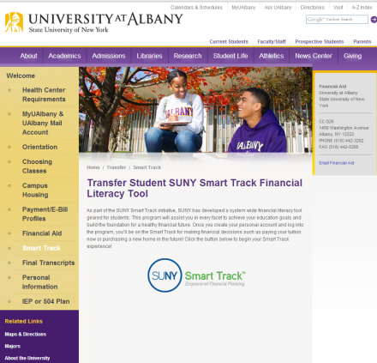
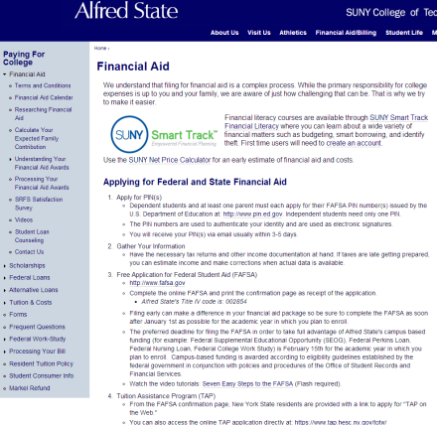
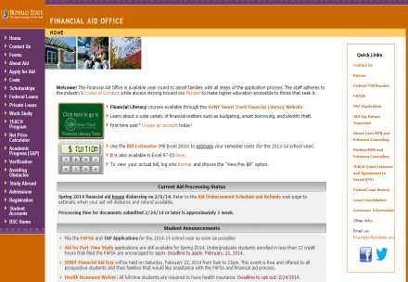
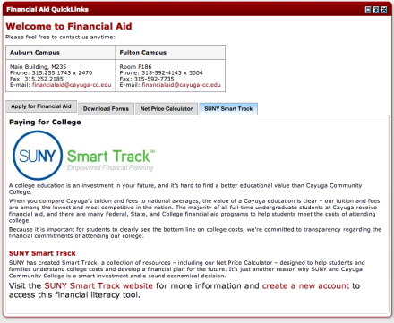
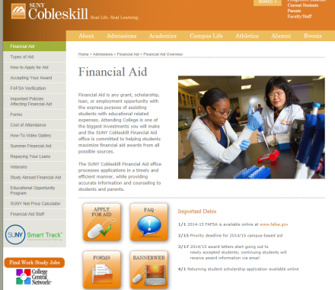
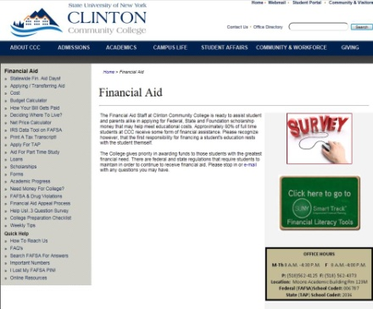
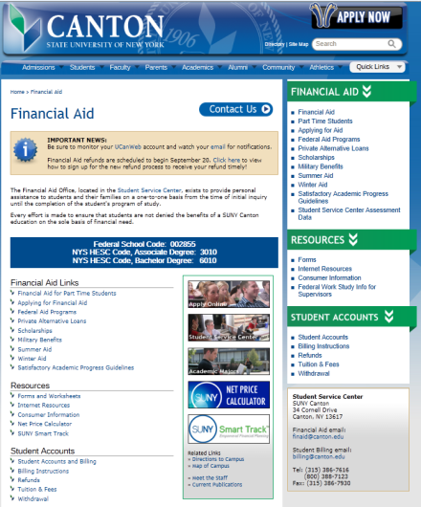
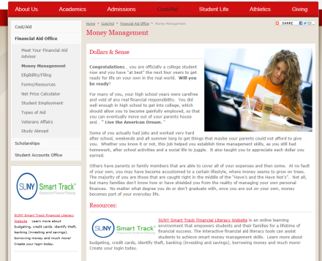
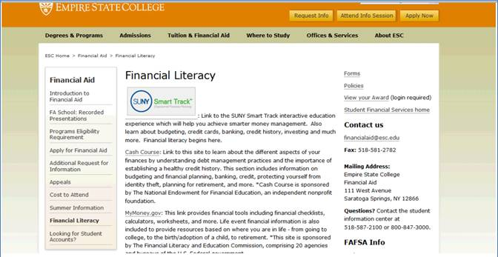
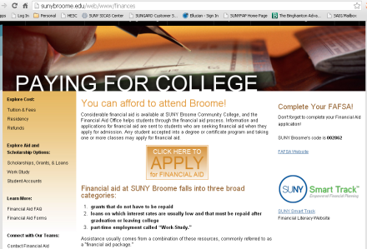
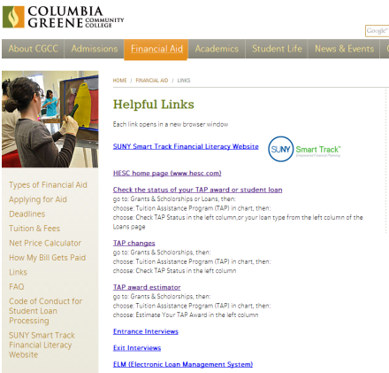
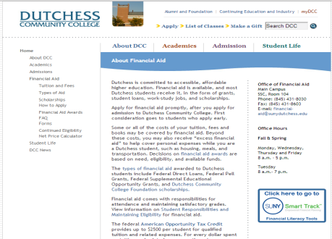
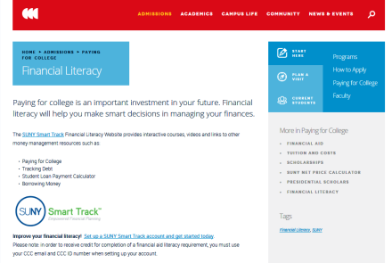
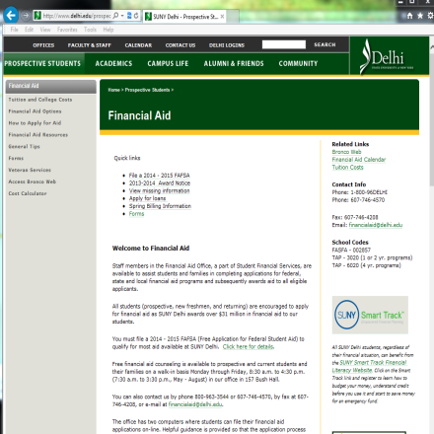
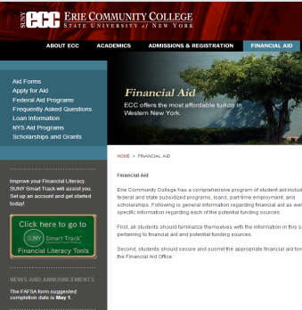
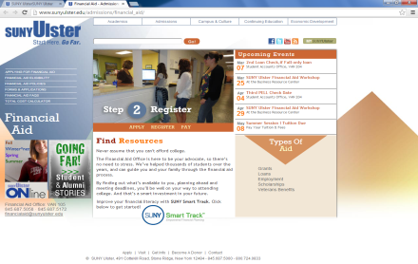
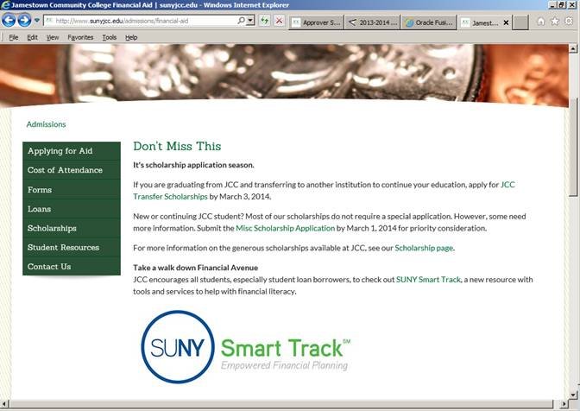
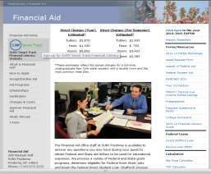
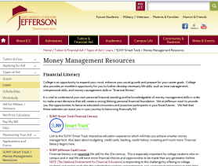
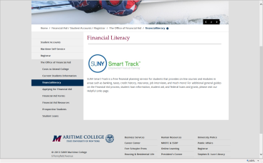
All SUNY University Centers, State Ops and Community
Colleges are linked to the SUNY Smart Track Financial
Literacy Website
Smart Track Financial Literacy Website (school websites)

Slide 14

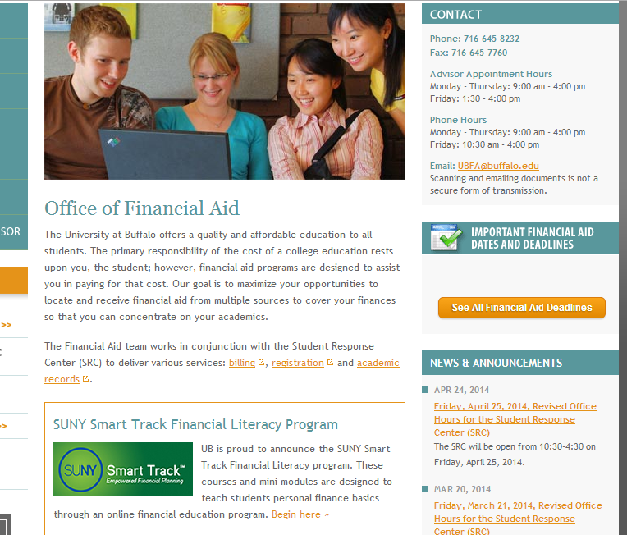
Get On The Right Track…
SUNY Knows…
Congratulations Kahlil Mack from the University of Buffalo… the Number 5 pick overall in NFL Draft goes to the Oakland Raiders!!!

Slide 15
Questions?

