Slide 1

Bigger Creativity: Visual and Performing Arts Majors

Slide 2

Why Study the Arts ?
Develop your creative potential
Arts are integral to every discipline
Exciting, unusual careers!
Contribute to our quality of life

Slide 3
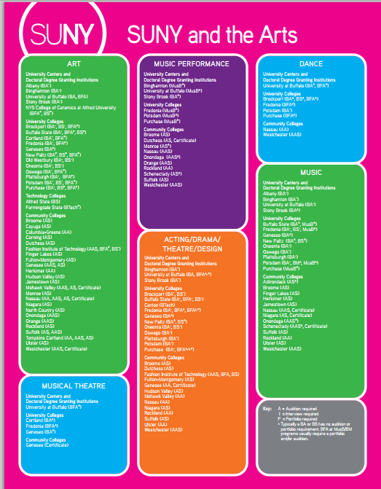
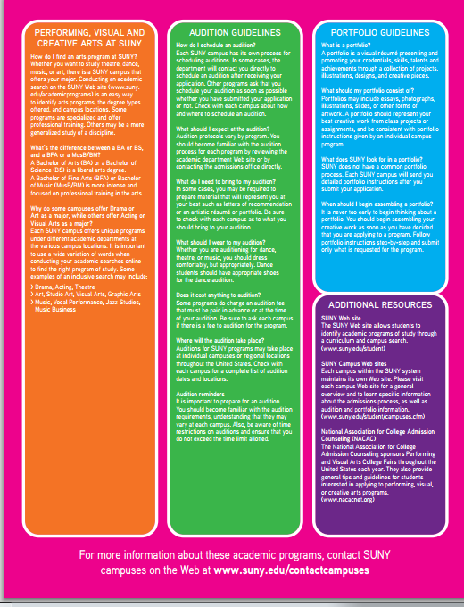
How do you Prepare for the Arts?

Slide 4

Meet our Campuses

Slide 5
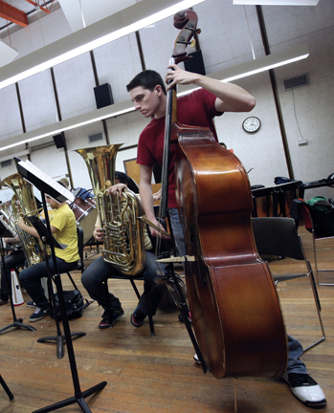
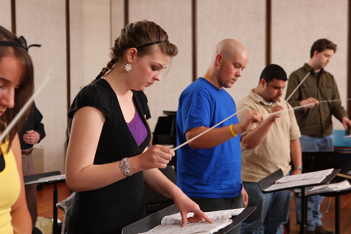

Performing Arts – Music (A.S.)
Designed for students who wish to transfer to a four-year program
Training in performance, theory, ear-training, music history and pedagogy
Audition required for admission

Slide 6
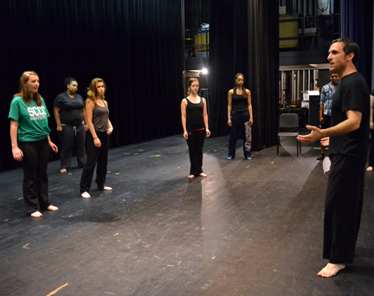
Liberal Arts: Humanities and Social Sciences (A.A.)
Drama Concentration
Core of six drama-related courses, which include traditional literature, theater, acting and performance
Required internship
10 SUNY General Education courses, thus making it very transfer-friendly

Slide 7


Slide 8


Slide 9

Purchase College
TYPES OF MAJORS IN THE ARTS

Slide 10

Purchase College
ARTS MAJORS & MINORS
BA
BFA
Art History Creative Writing
Arts Management New Media
Cinema Studies Playwriting and Screenwriting
Theatre and Performance
Acting
Art +Design (Graphic Design, Painting/Drawing, Printmaking, Photography, Sculpture)
Dance
Film
Music (Composition, Studio Composition, Studio Production, Performance: Jazz, Instrumental, Opera)
Theatrical Design (Costume, Lighting, Scenic, Technical Direction, Production Management)
Visual Arts - BS

Slide 11

B.A. Music, Bmus in Performance, Minor in Music
  Theory, and Performance Concentrations
B.A. in Theatre, Minor in Theatre, 5 Year B.A. Theatre/MPA option
  Acting/Directing, Dance, and Design and Technical Theatre Concentrations
B.A. Studio Art, Minor in Studio Art
  Drawing, Painting, Sculpture, Printmaking, and Graphic Design Concentrations

Slide 12
Students need to audition or provide portfolios into certain programs in order to major in them
Students do not need to be in the major in order to participate in many program offered in the arts
Special talent review is available to students not pursuing major
In addition to the fine arts Binghamton has a cinema major that many students will also participate in

Slide 13
Question and Answer

