Slide 1

Bigger Access: Educational Opportunity Program Updates and Enhancements

Slide 2

Educational Opportunity Program
Provides access for disadvantaged NYS residents who wish to attend the State University.
Offered by 43 of the 64 SUNY campuses, including 13 community colleges.
Serves approximately 10,000 students annually, enrolling 3,000 new students per year.
Has produced more than 55,000 graduates.

Slide 3

Eligibility Requirements
Ineligible for admission under traditional standards, but demonstrate potential for completing a college program
In need of financial assistance within income guidelines
Full-time
New York State resident for 12 months prior to enrollment

Slide 4
EOP Income Guidelines 2014-15
Household Size | Annual Income
1 | $21,590
2 | $29,101
3 | $36,612
4 | $44,123
5 | $51,634
6 | $59,145
7 | $66,656
8 | $74,167
*Plus $7,511 for each additional household/family member in excess of eight.

Slide 5
Income Guidelines Do Not Apply If:
The student’s family is the recipient of Family Assistance or Safety Net payments through the New York State Office of Temporary and Disability Assistance; or through a county Department of Social Services; or Family Day Care payments through the NYS Office of Children and Family Assistance;
The student lives with foster parents who do not provide support for college and the student’s natural parents provide no such support;
The student is a ward of the state or county.

Slide 6
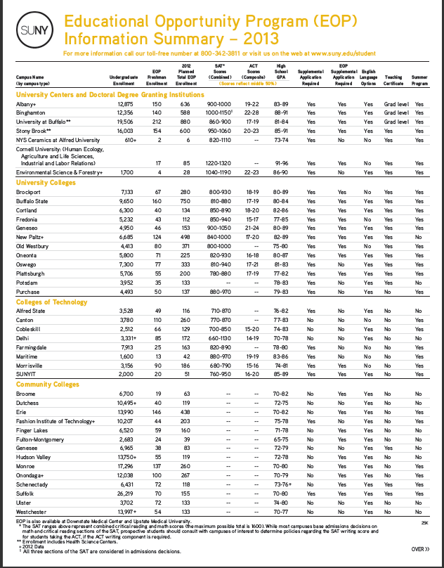
EOP Academic Guidelines

Slide 7
Pre-Freshman Summer Program
The EOP summer experience provides students with an opportunity to acclimate to the college environment prior to fall matriculation.
Summer programs exist on approximately 25 campuses, including community colleges.
Program ranges from 3 days to 5 weeks in length.
Notes:
In most cases, students receive instruction and other support services in preparation for the first year of their college experience

Slide 8
Important Information
To ensure maximum attention is provided to qualified applicants, students who do not meet the income and academic requirements should not apply.
Educational Opportunity Program direct aid is modest and does not support tuition costs.
Early application is strongly encouraged as capacity is limited.
Consistent and aggressive follow-up by the student and guidance counselor is important.
Notes:
An average of 8,900 eligible applicants cannot participate due to limited capacity.

Slide 9
Up to four (4) application fee waivers for students applying for EOP
SAT/ACT scores
Campus interviews
EOP students cannot apply Early Decision/
Early Action
Other college options for EOP ineligible applicants (community college, EOC)

Slide 10

Application Process for Freshmen
Students must indicate interest in EOP on the application for admission.
Complete the supplemental application.
Complete the EOP supplemental application.
Submit letters of recommendation from school counselors and teachers.

Slide 11
EOP Supplemental Application v.2
Fall Release:
  Data to be collected online
  Paperwork to be mailed to ASC
Launch date: August 1
Participating campuses: Alfred State; SUNY Cobleskill; SUNY Cortland; Finger Lakes CC; Maritime College; Morrisville State; Old Westbury; College at Oneonta; SUNY Oswego; SUNY Potsdam; Purchase College
Goal: One common form for all EOP campuses

Slide 12


Slide 13
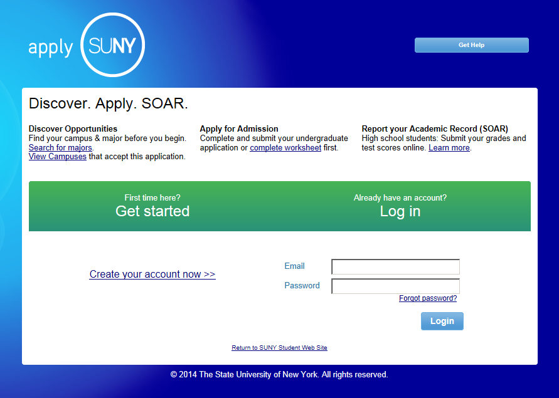

Slide 14
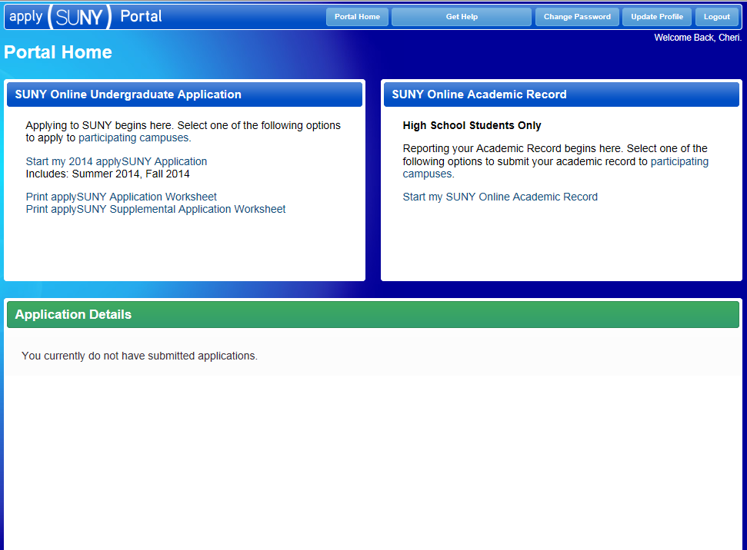

Slide 15
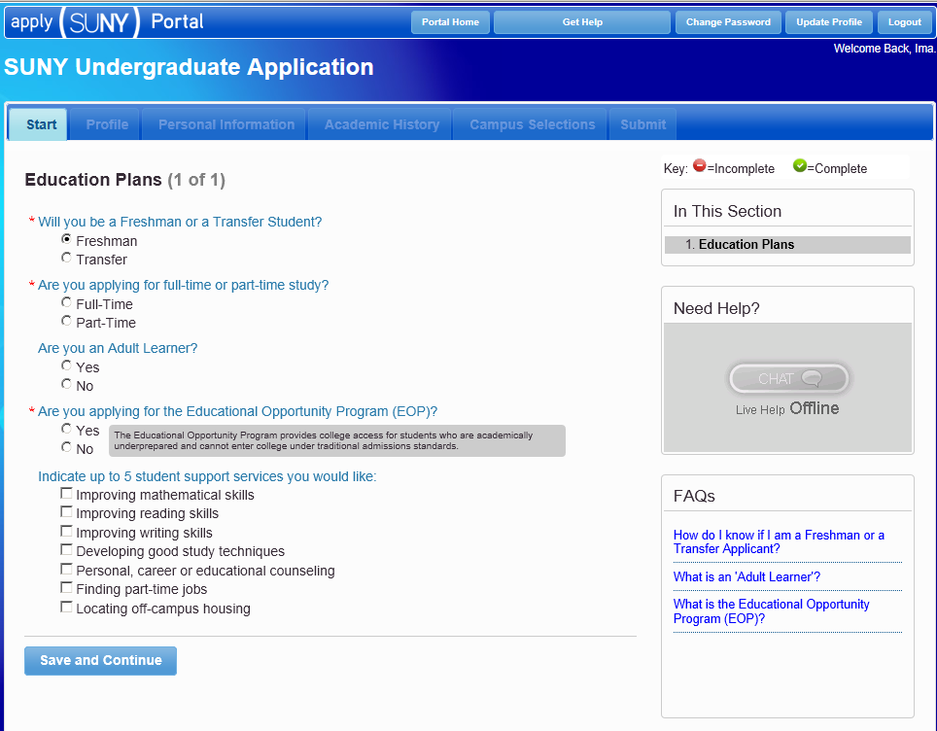

Slide 16
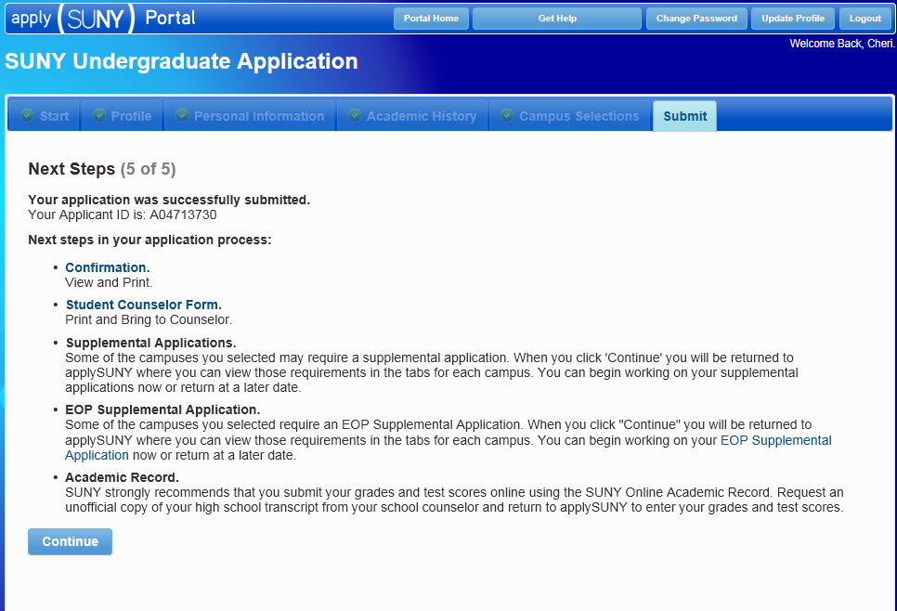

Slide 17
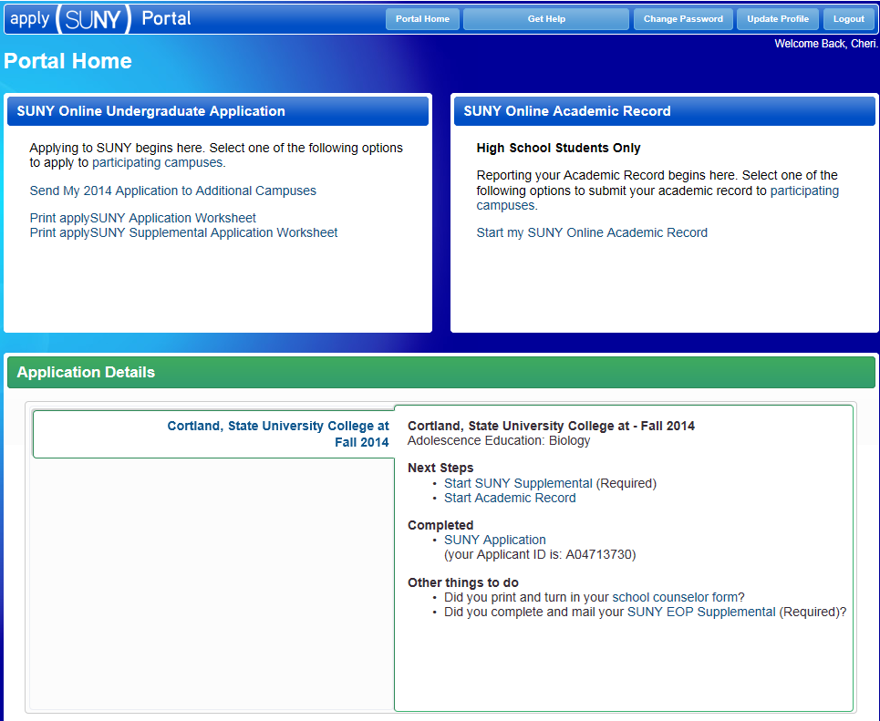

Slide 18
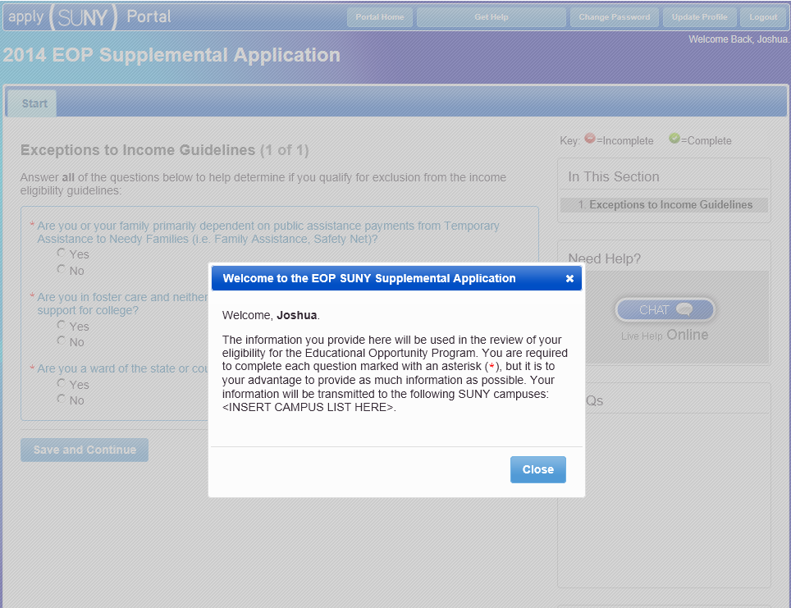

Slide 19
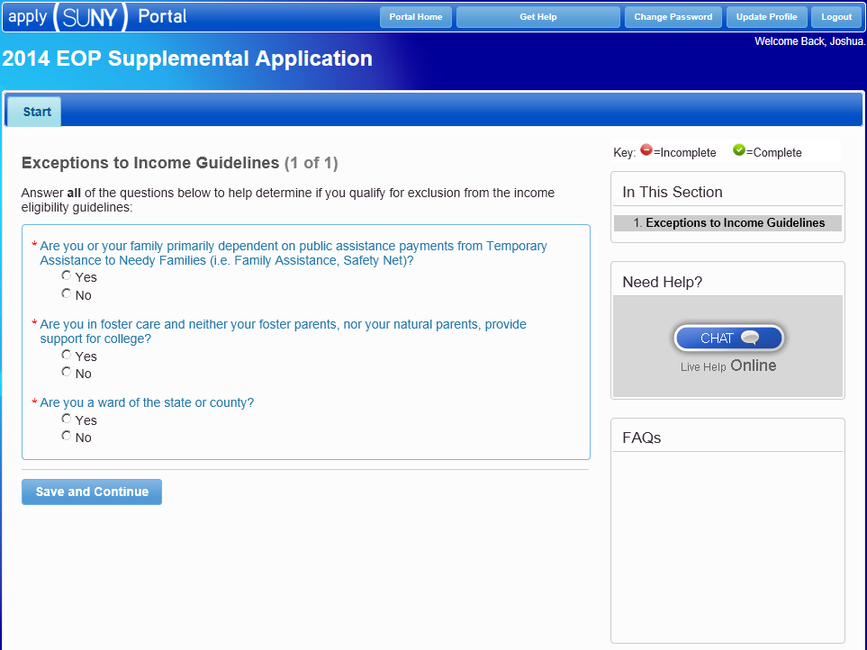

Slide 20
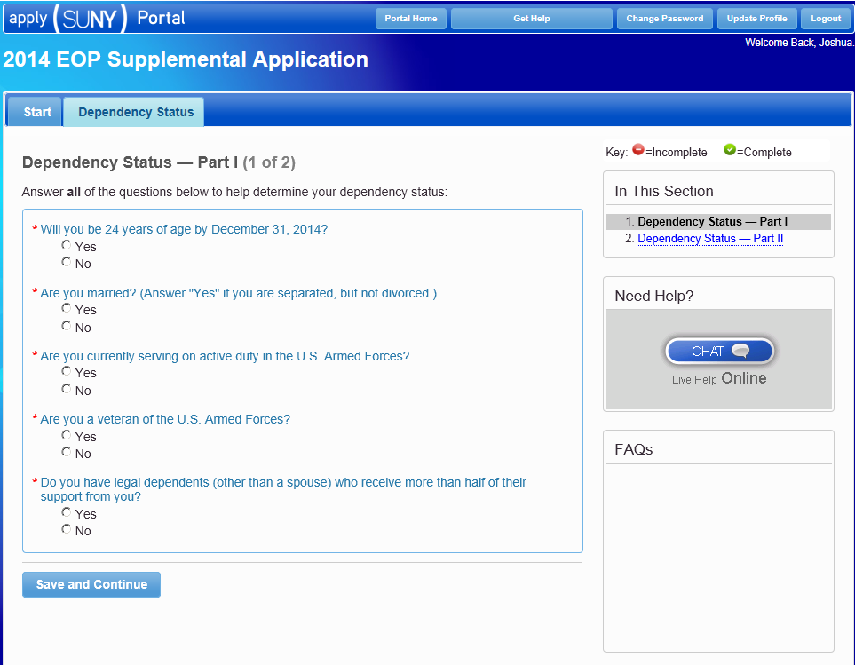

Slide 21
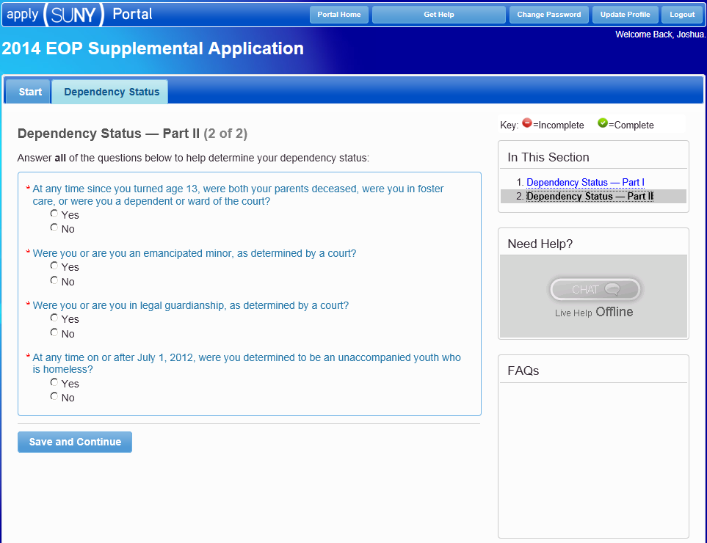

Slide 22
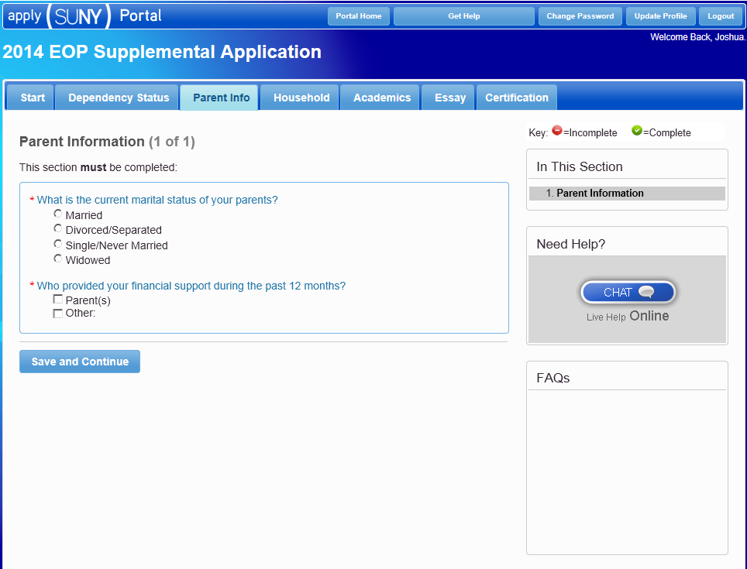

Slide 23
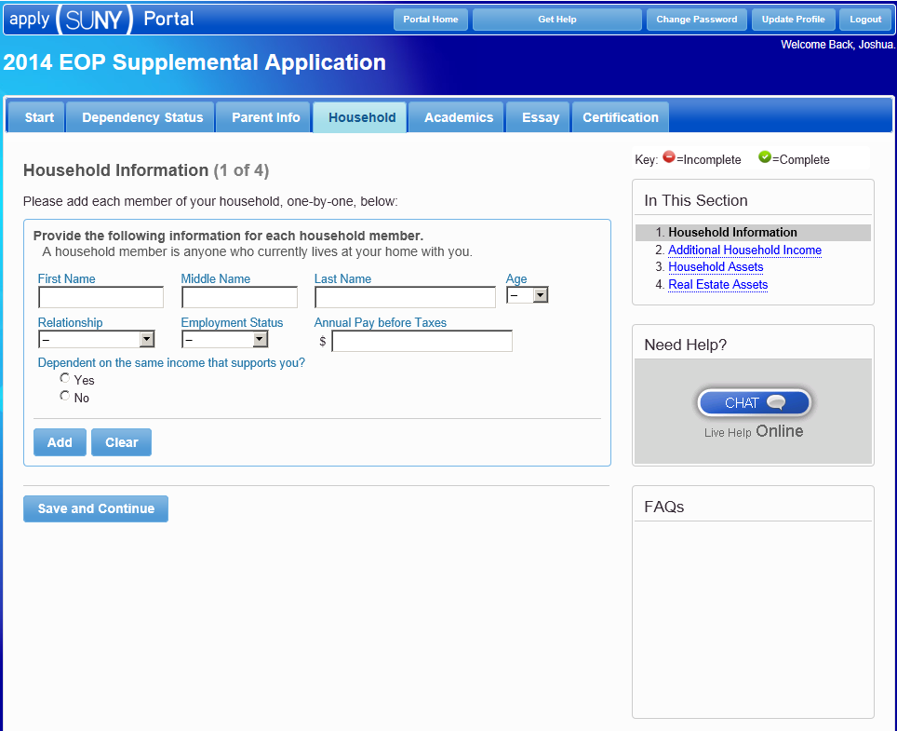

Slide 24
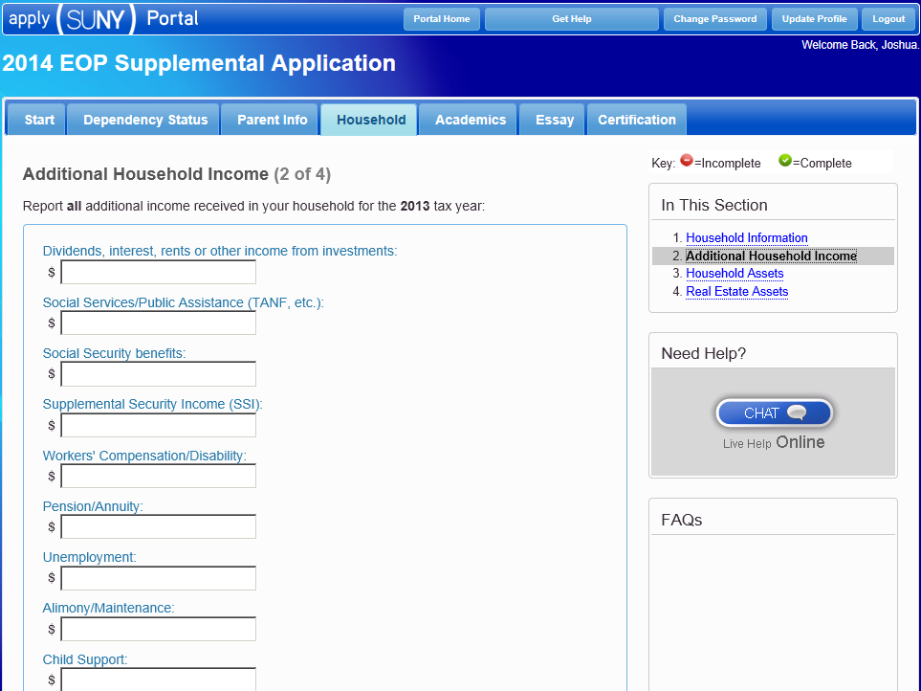

Slide 25
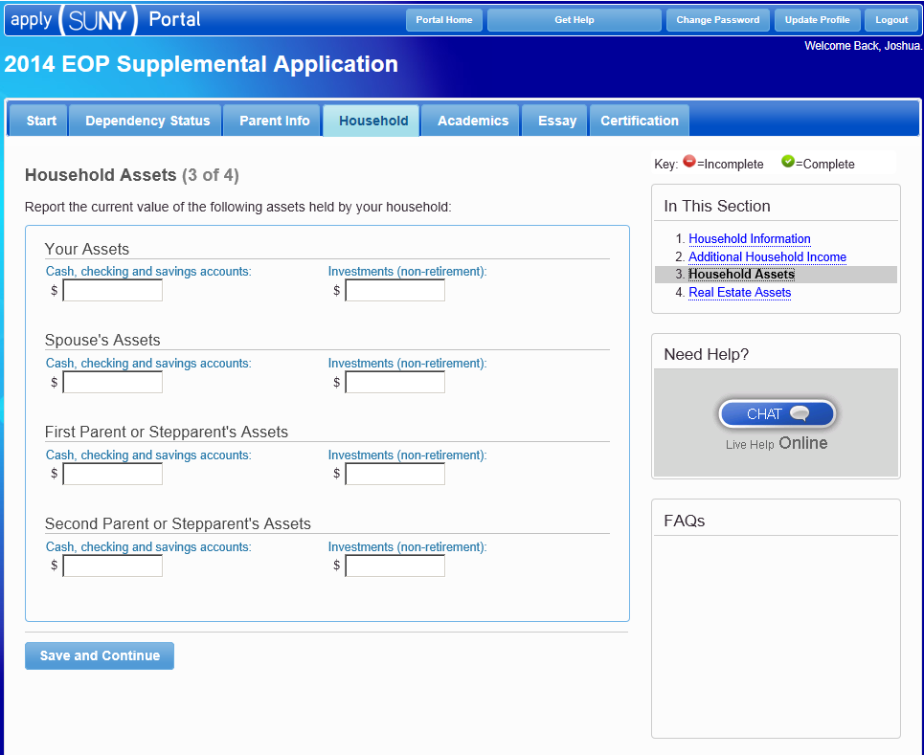

Slide 26
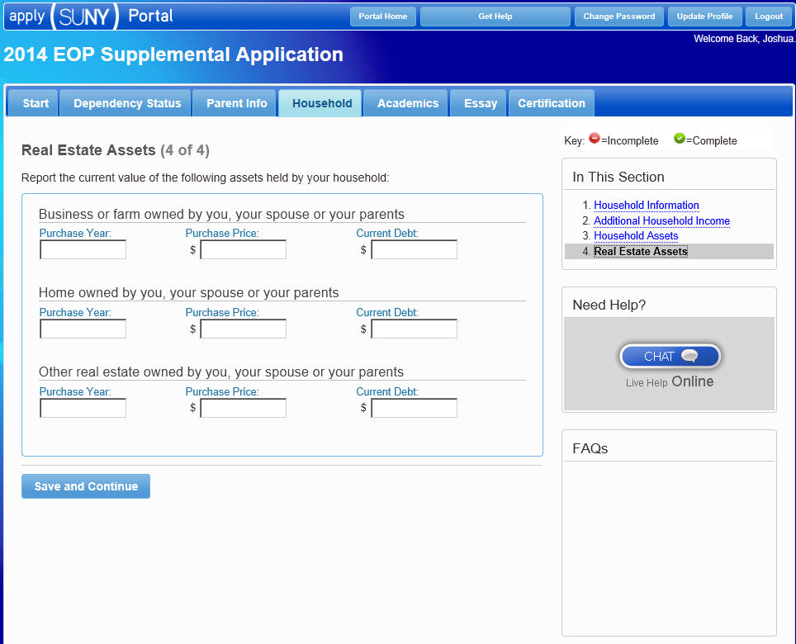

Slide 27
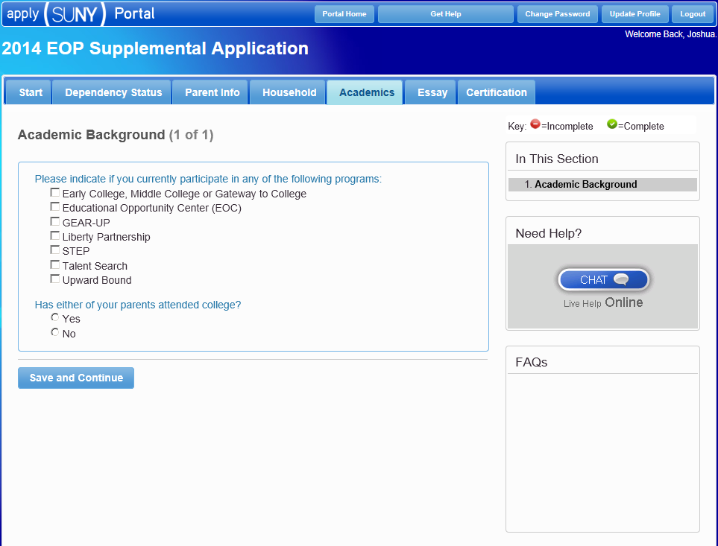

Slide 28
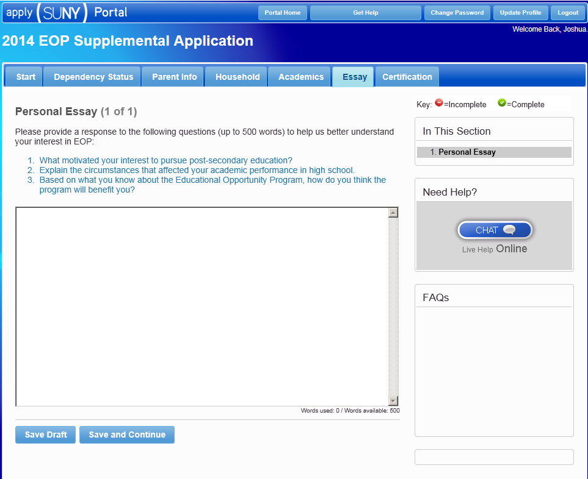

Slide 29
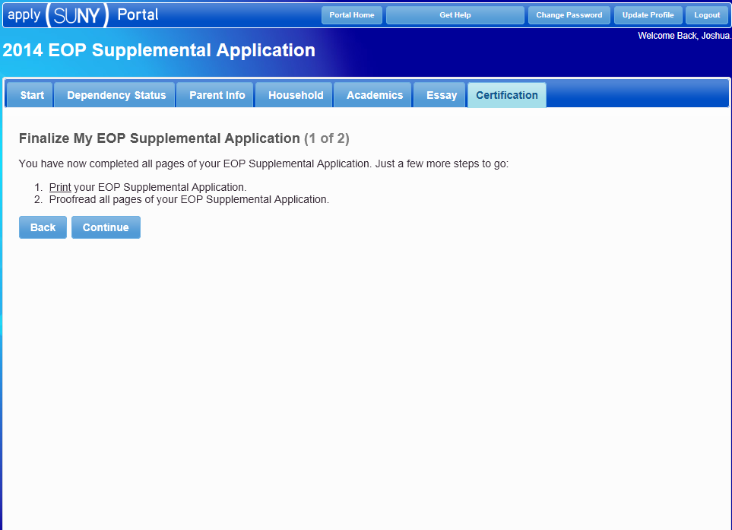

Slide 30
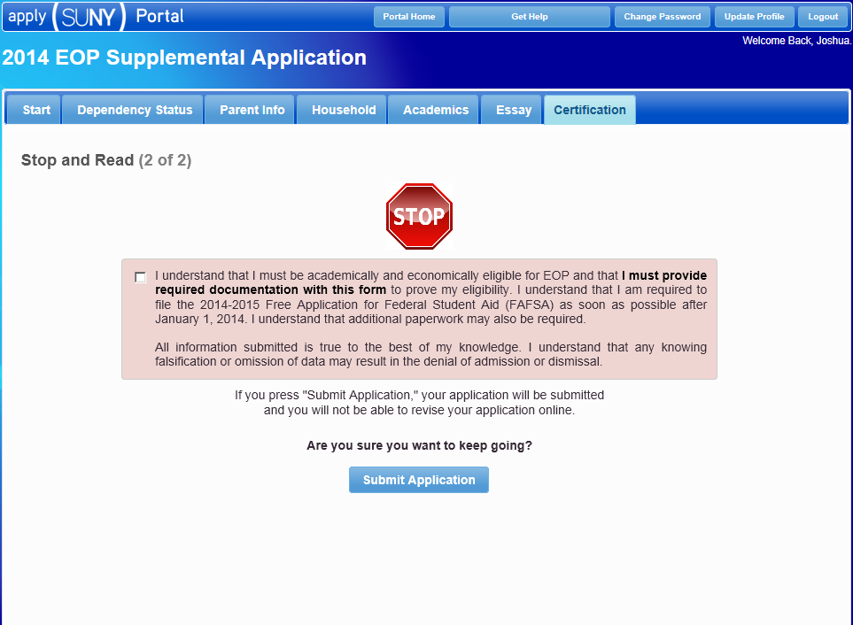

Slide 32

Questions

