Slide 1

Pathways & Partnerships in SUNY

Slide 2
OpInform 2016
Your Students have Options
Not every student gets admitted to his or her first choice.
Some are admitted, but for a variety of reasons (personal, health, financial) do not go directly to the four-year college from high school.
More easily than ever, your students can start at one SUNY and still go to that “first choice” further down the road.

Slide 3
OpInform 2016
2+2 Dual Admission
Dual admission is an agreement between two regionally accredited two-year and four-year institutions that allows for a seamless transfer, spending two years at each institution.
Students will likely have to maintain a specific gpa and complete certain prerequisite coursework and number of credits before moving on to the four year college.

Slide 4
OpInform 2016
Benefits of 2+2 Dual Admission
A more simplified admissions process
Confirms the transferability from a two-year institution to a four-year institution
Guarantees acceptance into the transfer institution, if all guidelines and criteria required are completed
Students are simultaneously admitted to the community college and four-year college at the start of their freshman year.
ACE and AP credits may be used, if they are applicable to the specific field.
The process is seamless.

Slide 5
OpInform 2016
What is an Articulation Agreement?
An articulation agreement is an official/formal agreement between a two- and four-year regionally accredited school which allows for credits to be applied to a specific program.

Slide 6
OpInform 2016
What is the purpose of an Articulation Agreement?
The concept of an articulation agreement is “mapping and planning for student success.”
The intent of an articulation agreement is to facilitate transfer between a specific major at a community college and a specific major at a four-year college.
The agreement allows a community college student to complete an A.A. or A.S. degree and then transfer to the four-year institution with full junior status.
The process is seamless.

Slide 7
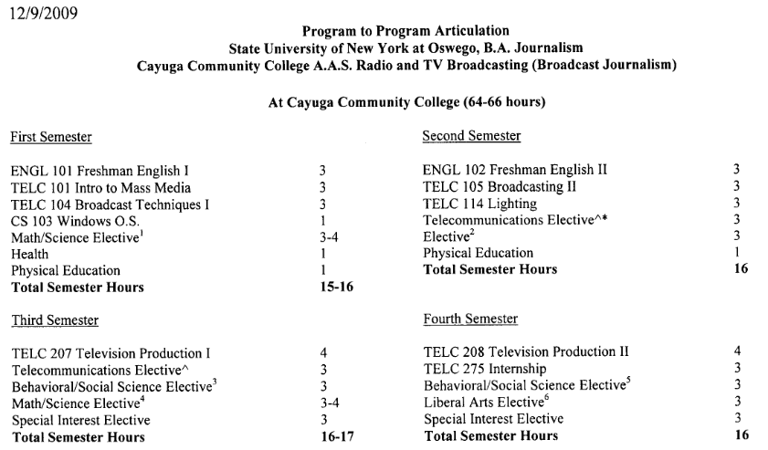
OpInform 2016
Example of an Articulation Agreement

Slide 8
OpInform 2016
SUNY “Gen Eds”
Bachelor’s degree candidates must complete 30 credits of general education coursework in 7 of 10 knowledge and skills areas.
Knowledge and skill areas include: Mathematics, Natural Science, Social Science, American History, Western Civilization, Other World Civilization, Humanities, Arts, Foreign Language and Basic Communication.
Designed to ensure liberal arts core
Designed to promote transfer of credits

Slide 9
OpInform 2016
Transfer Paths
Transfer Paths summarize the common lower division requirements shared by all SUNY campuses for similar majors within a specific discipline.
Core Lower Division Major requirements
+ Gen Ed requirements
= recommended path for first 2 years of study

Slide 10
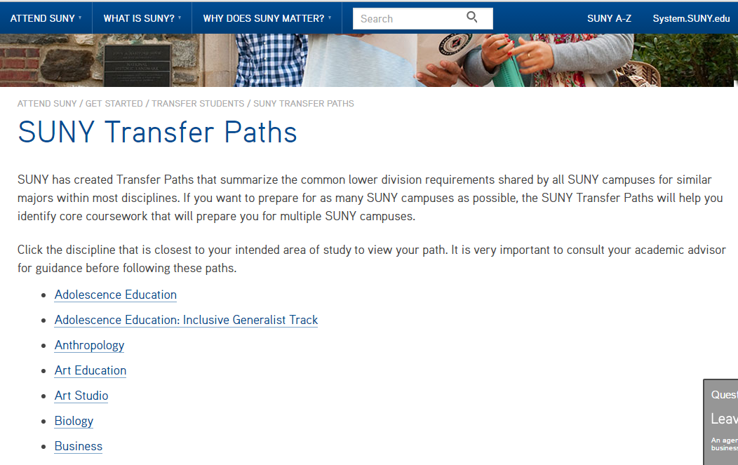

Slide 11
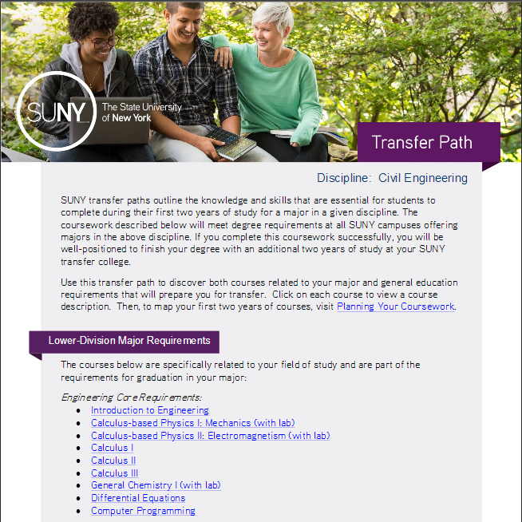
OpInform 2016

Slide 12
OpInform 2016
Unique Arrangements and Agreements
Start Now Program
Arrangement between SUNY Oswego and Jefferson Community College
Begun in 2016
Offers students interested in Oswego a “path to success” by starting at JCC
Includes advisement, trips to campus, student mentoring and more
Being piloted for NYC students
To be scaled up and replicated across SUNY in future years

Slide 13
OpInform 2016
Unique Arrangements and Agreements
Binghamton Advantage Program
Arrangement between Binghamton University and Broome Community College
Live on the Binghamton campus, but attend classes at Broome
Enjoy campus life opportunities on both campuses
Begin classes at Binghamton in sophomore or junior year

Slide 14
OpInform 2016
Unique Arrangements and Agreements
Degree Ladders
Many Colleges of Technology offer both associate and bachelor’s degree programs.
Provides an opportunity for students who do not meet the more rigorous bachelor’s degree requirements to begin in the associate degree program
After graduation, students can immediately transition into the junior year of the bachelor’s degree program—all at the same college!

Slide 15
OpInform 2016
Unique Arrangements and Agreements
Regional College Alliances
Available at some community colleges
Students can begin their education at a traditional community college and then stay on campus to pursue a higher degree from a partner, four-year college.
SUNY Adirondack’s Regional Higher Education Center houses its partners, SUNY Plattsburgh, Empire State College and Paul Smith’s College, so that students can earn a bachelor’s and/or master’s degree from one of these partner colleges without leaving the area!

Slide 16
OpInform 2016
SUNY Transfer Guarantee
“New York State residents who are graduates of a State University of New York two-year college or a City University two-year college, including University community colleges operating under the program of the University, and who possess an A.A. or A.S. degree, shall be guaranteed an opportunity to continue their education on a full-time basis at a baccalaureate campus of the University.”

Slide 17
OpInform 2016
SUNY Transfer Guarantee
Students must go directly from the associate program to bachelor’s (no college in between).
Students must have earned A.A. or A.S. degree (not applicable to A.A.S. or A.O.S.).
Students are not guaranteed the campus or program of their choice, although every effort is made to work with students who have restrictions, i.e. family situations.
Must meet deadlines (apply by 10/1 for spring and 3/1 for fall)
Need to have been denied admission at all four-year SUNY choices

Slide 18
OpInform 2016
In Summary
Students can get to where they want to be in SUNY more easily than ever before.
Lots of support is available.
If a student ever needs assistance, admissions staff at either a two-year or four-year SUNY campus can help.

Slide 19
OpInform 2016
Questions?

