Slide 1

SUNY Update 2014

Slide 2


Today’s Program
Imagine Their World Bigger
  Degrees with High Employment Options
  Degrees that Speed Completion
  Degrees that Minimize Debt
Recruitment Updates
Application Updates

Slide 3




Slide 4
Degrees with High Employment Options
High needs areas
  Engineering – Engineering Technologies
  Healthcare
  Renewable – Clean Energy
  Biomedical
  Agriculture
  Information Technology
36 campuses awarded $12 million to meet
demand

Slide 5
Degrees that Speed Completion
Caps on number of credits required to complete
Online offerings
Seamless transfer

Slide 6


Slide 7
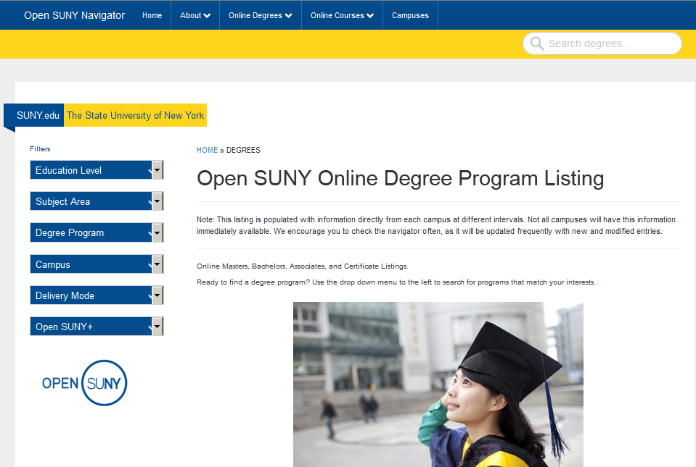

Slide 8


Slide 9
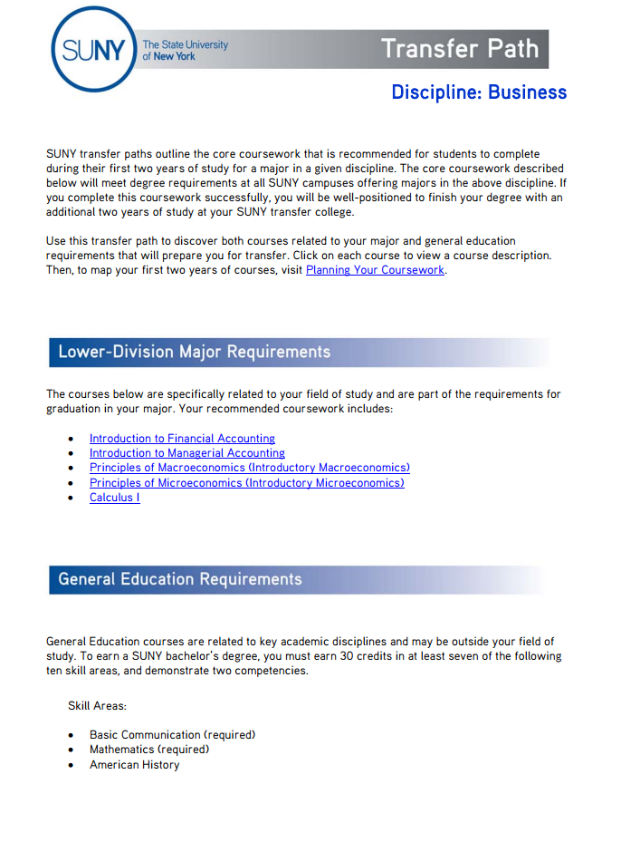
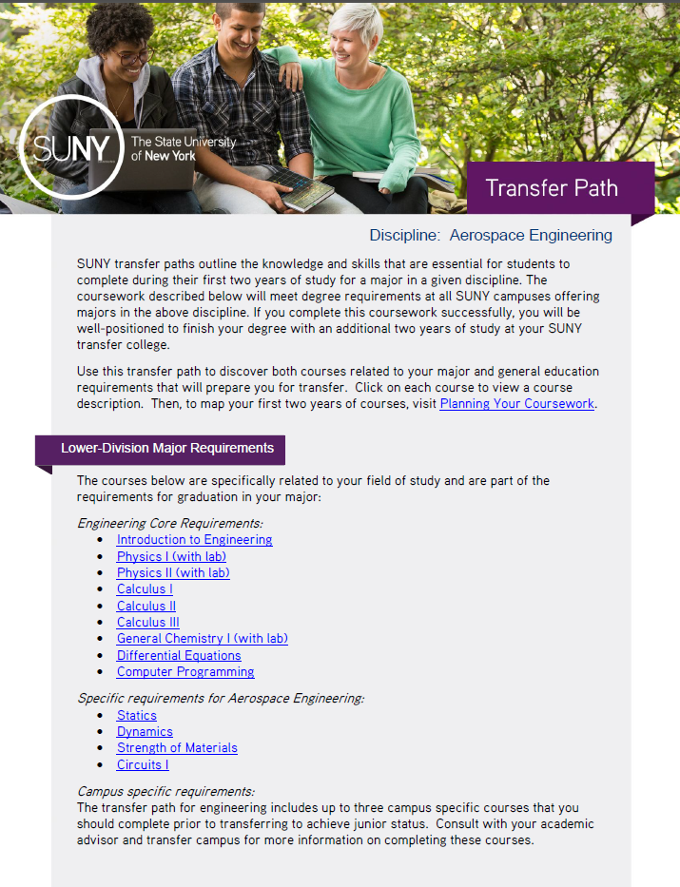
Seamless Transfer: Transfer Paths 2.0

Slide 10
Degrees that minimize debt
  Competitive tuition and fees
  Rational tuition plan
  Financial literacy

Slide 11


Slide 12
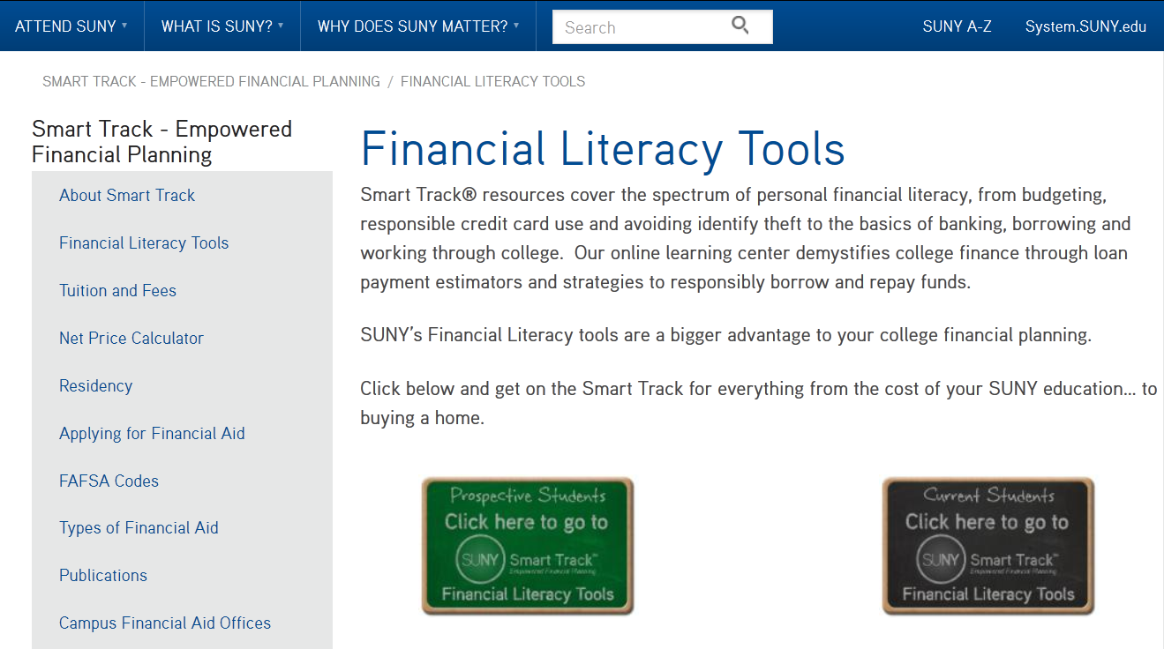

Slide 13
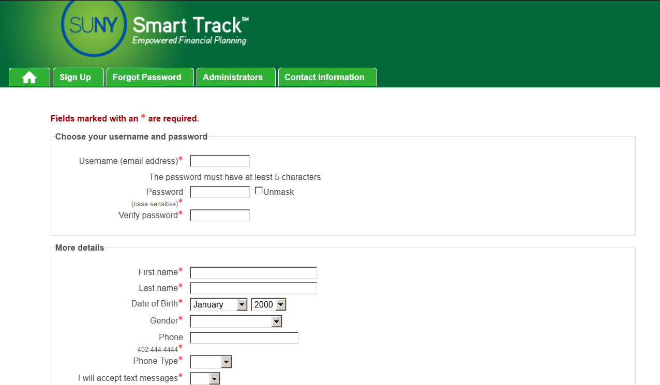

Slide 14
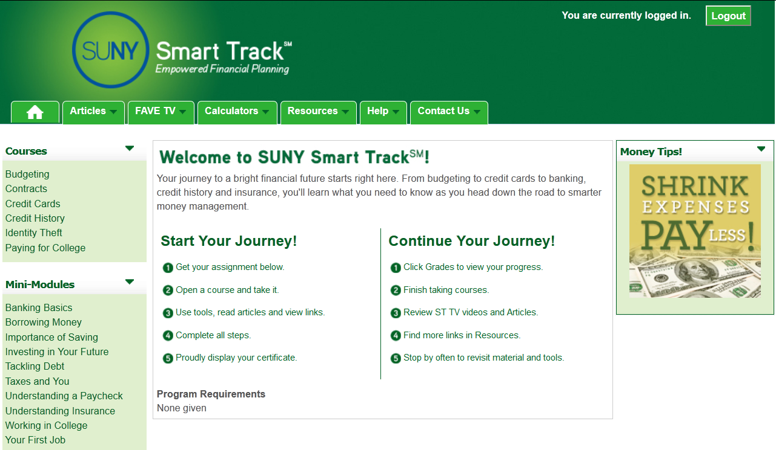

Slide 15
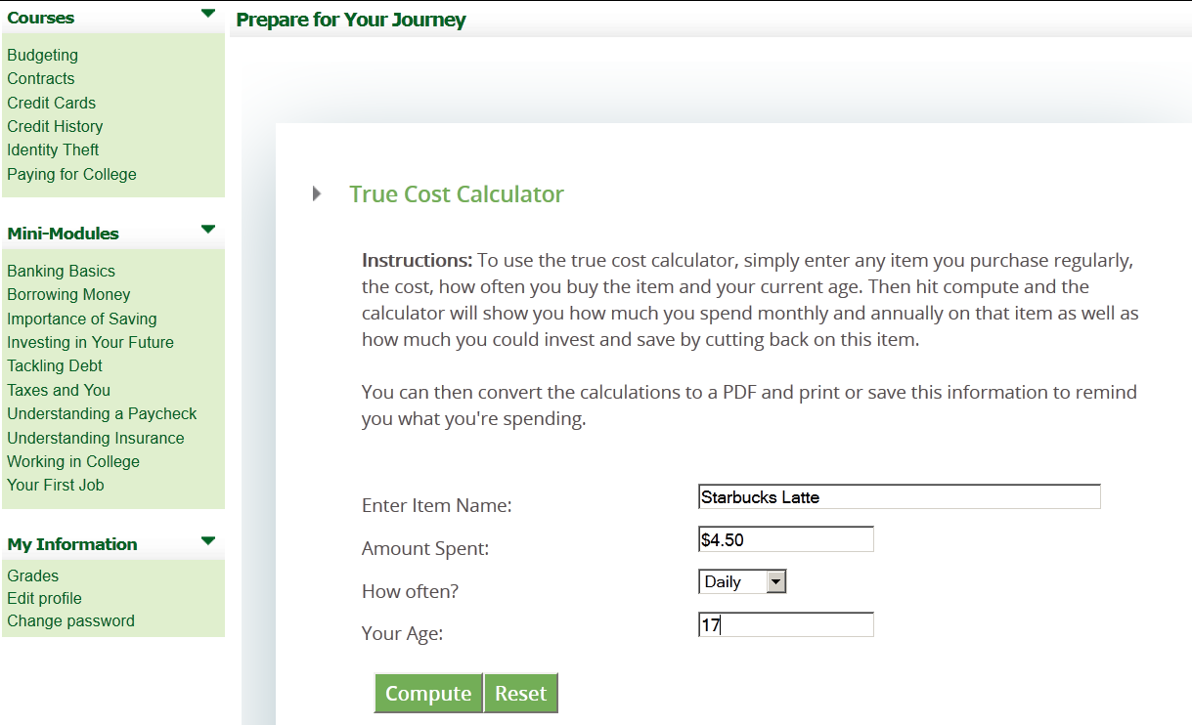

Slide 16
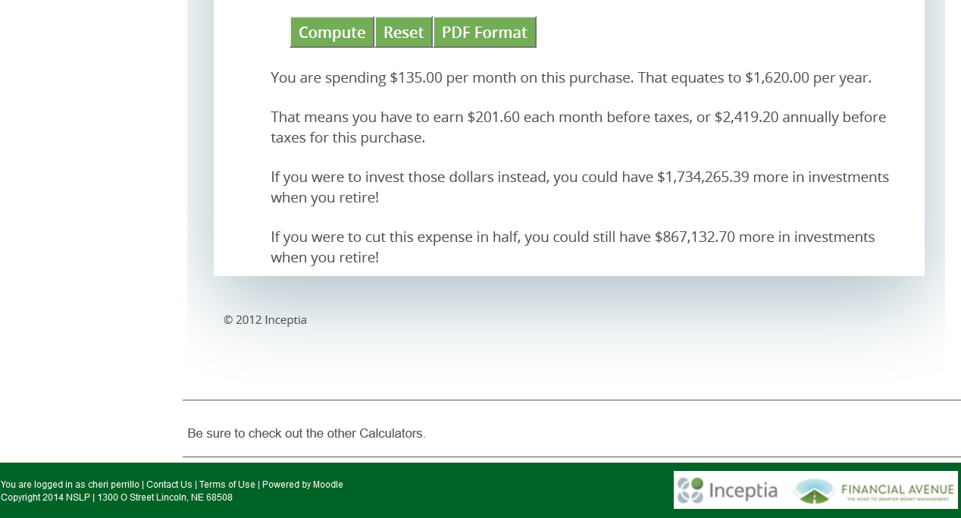

Slide 17
Recruitment
Updates

Slide 18

Recruitment Updates: Viewbook

Slide 19

Recruitment Updates: Counselor Packet

Slide 20
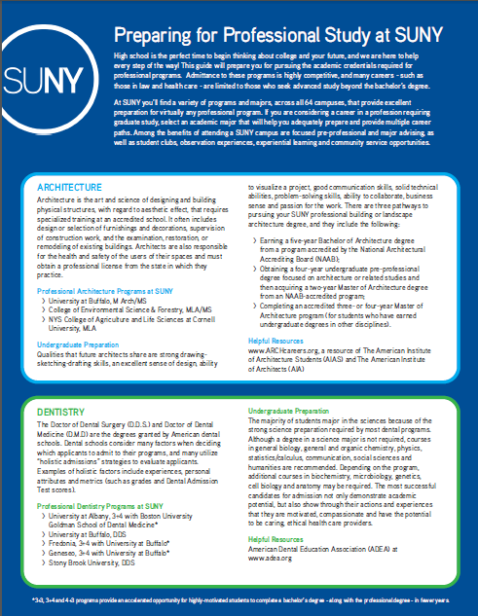
Recruitment Updates: Guides to Majors

Slide 21

Recruitment Update: Events

Slide 22

Recruitment Updates

Slide 23

Application Updates

Slide 24
Application
Updates

Slide 25


Slide 26
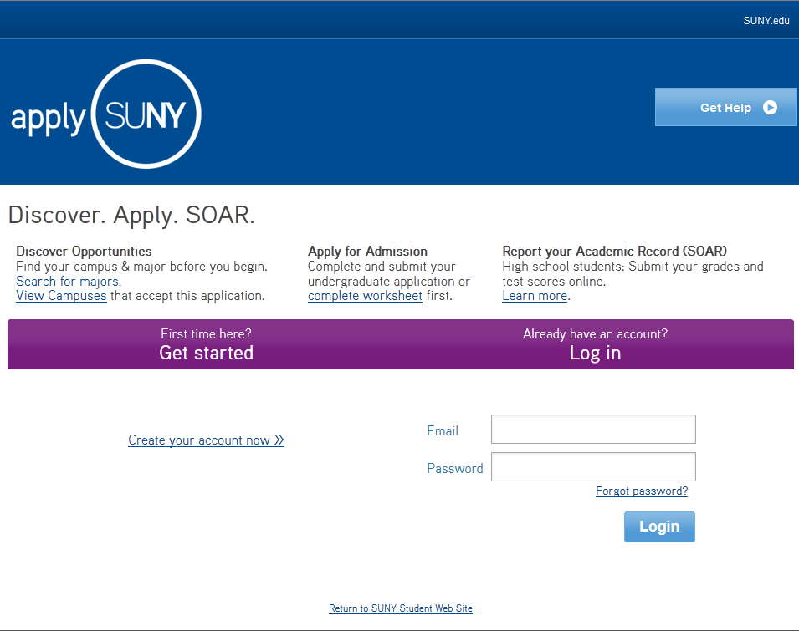

Slide 27
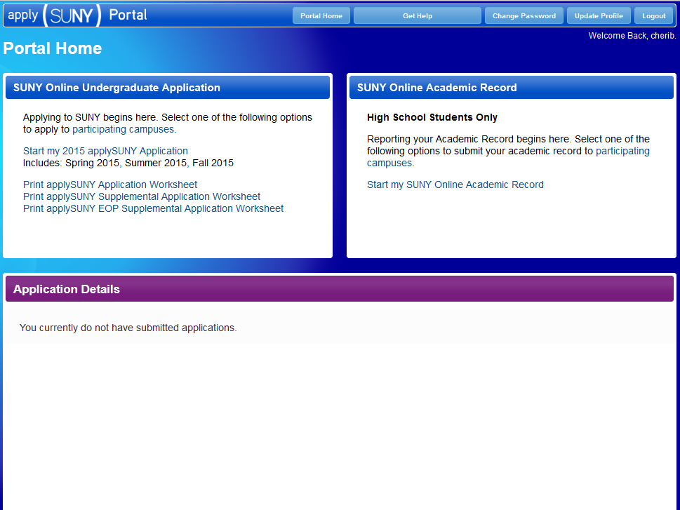

Slide 28
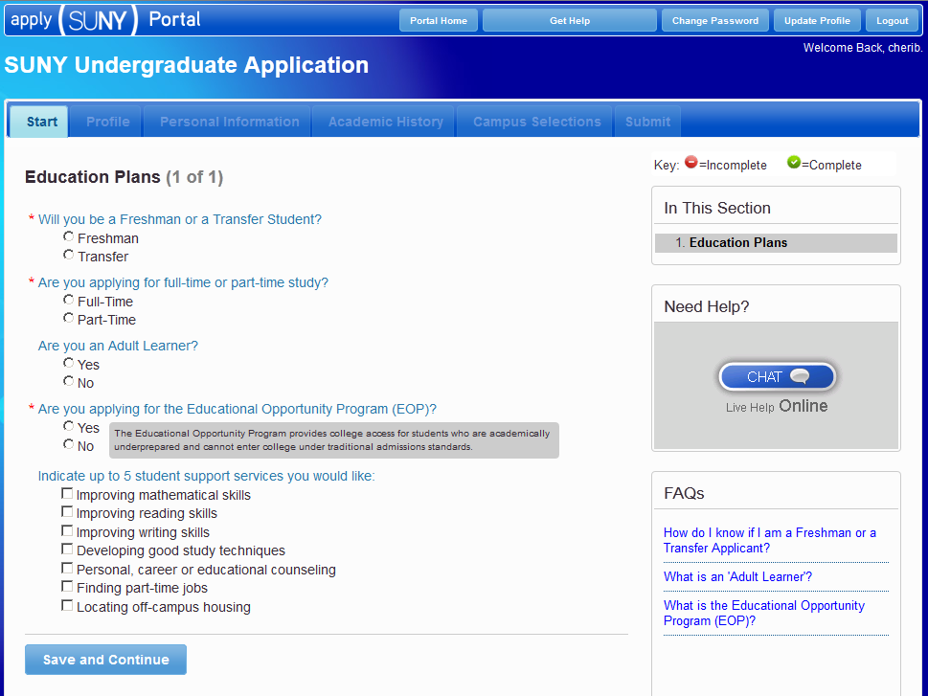

Slide 29
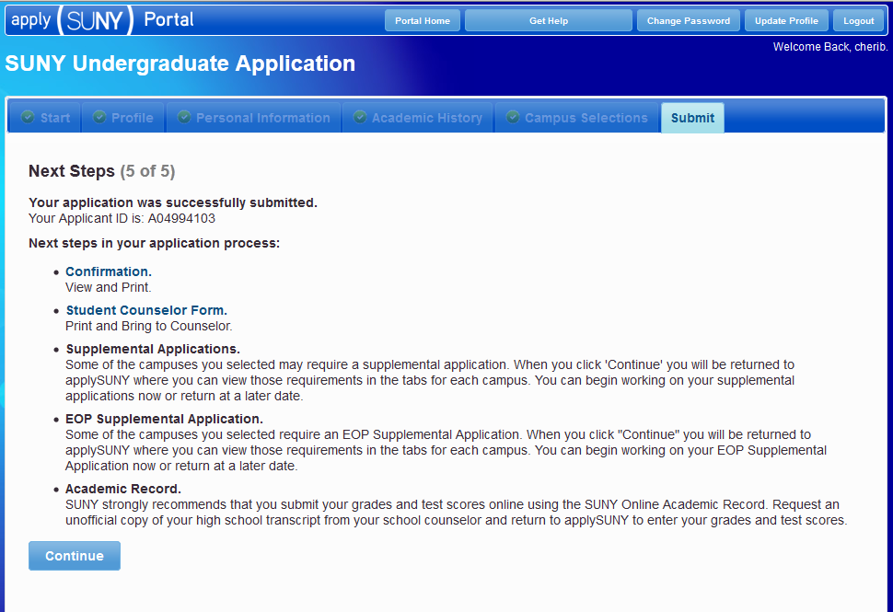

Slide 30
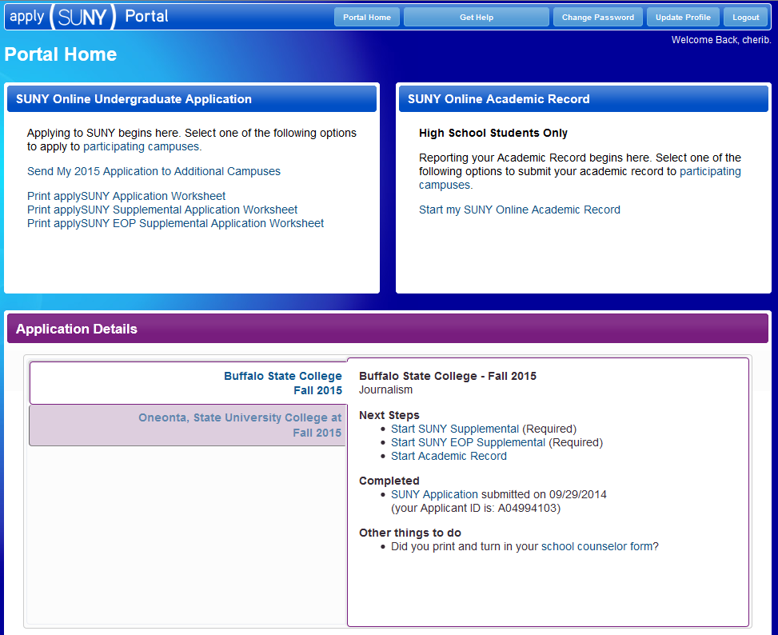

Slide 31
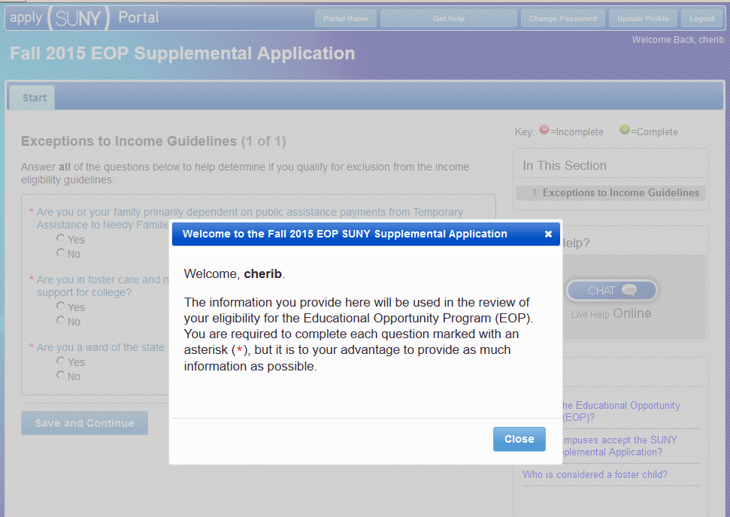

Slide 32
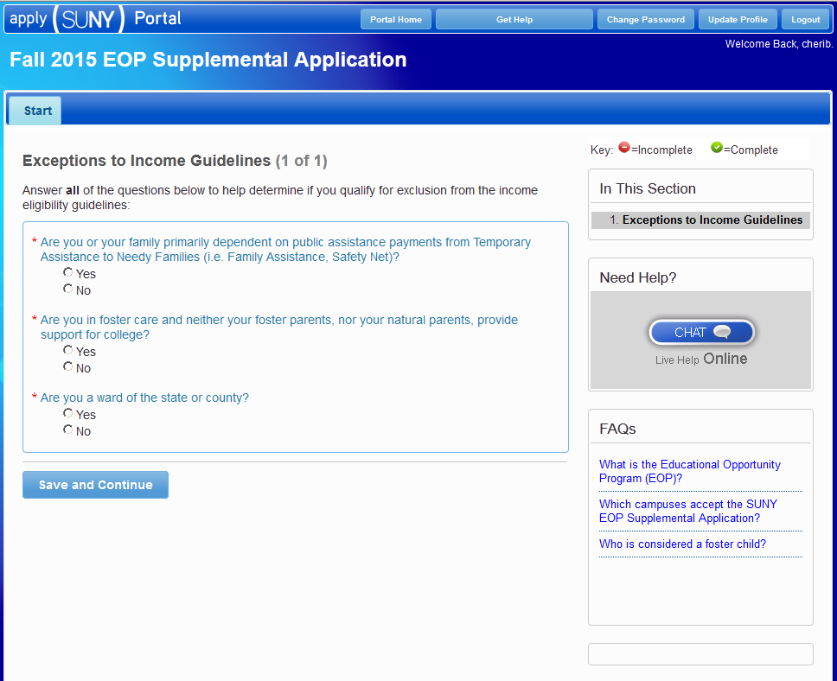

Slide 33
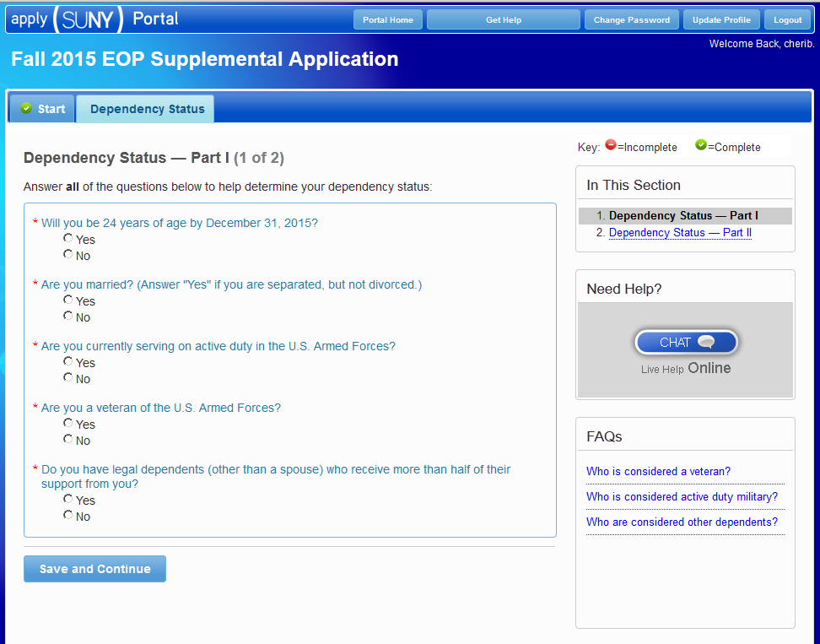

Slide 34
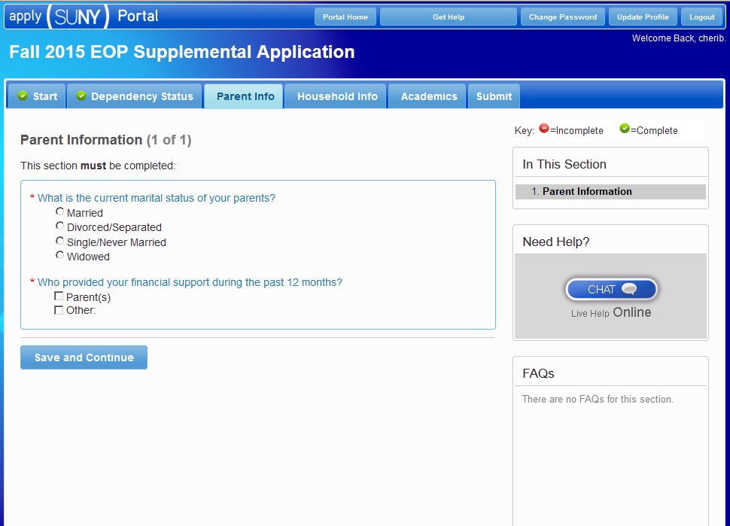

Slide 35
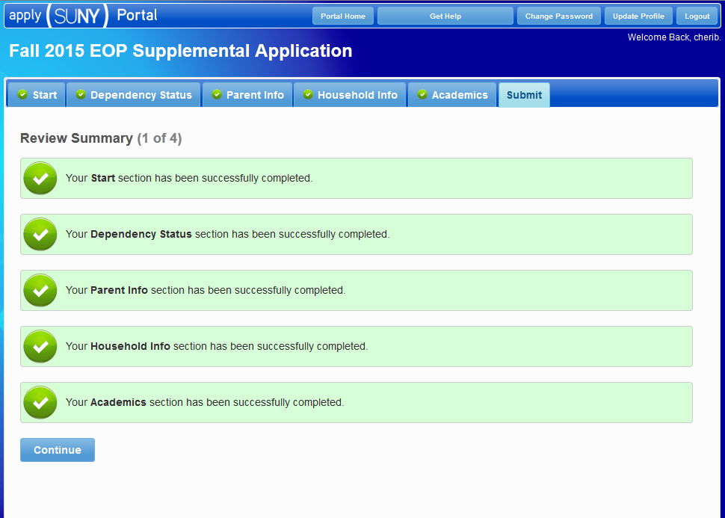

Slide 36
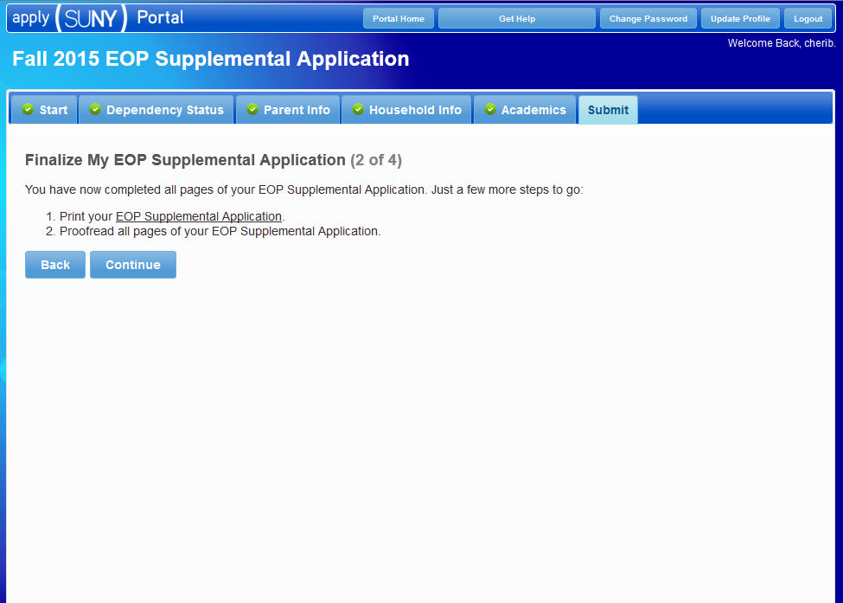

Slide 37
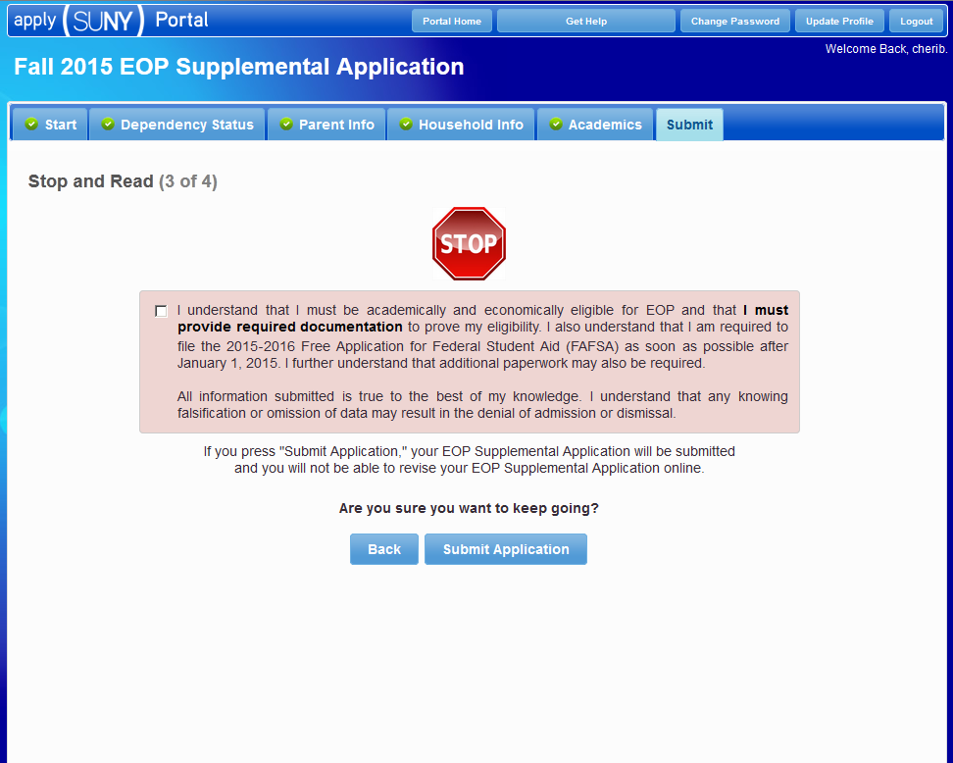

Slide 38
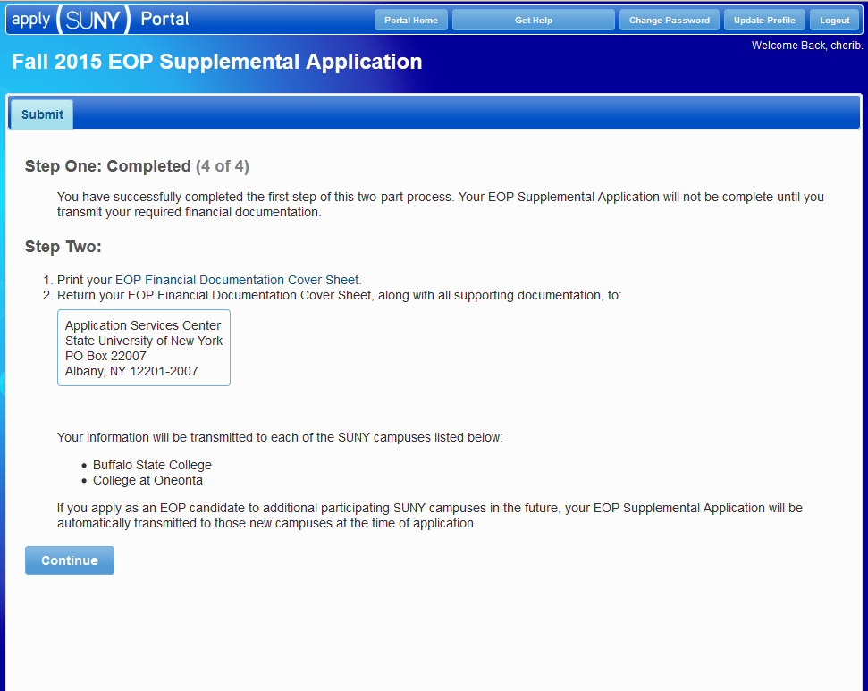

Slide 39
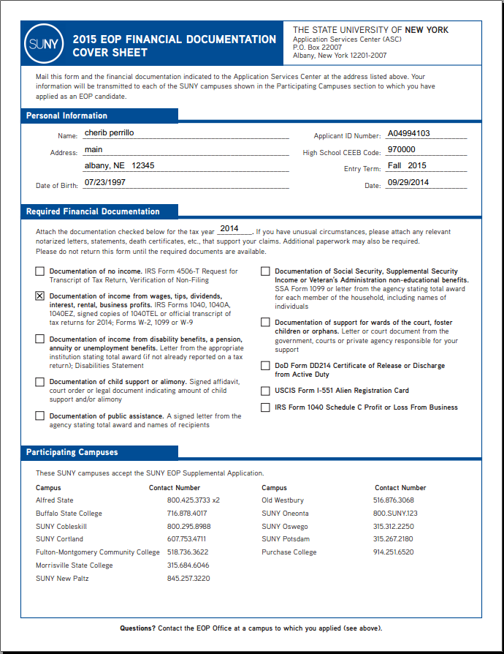

Slide 40
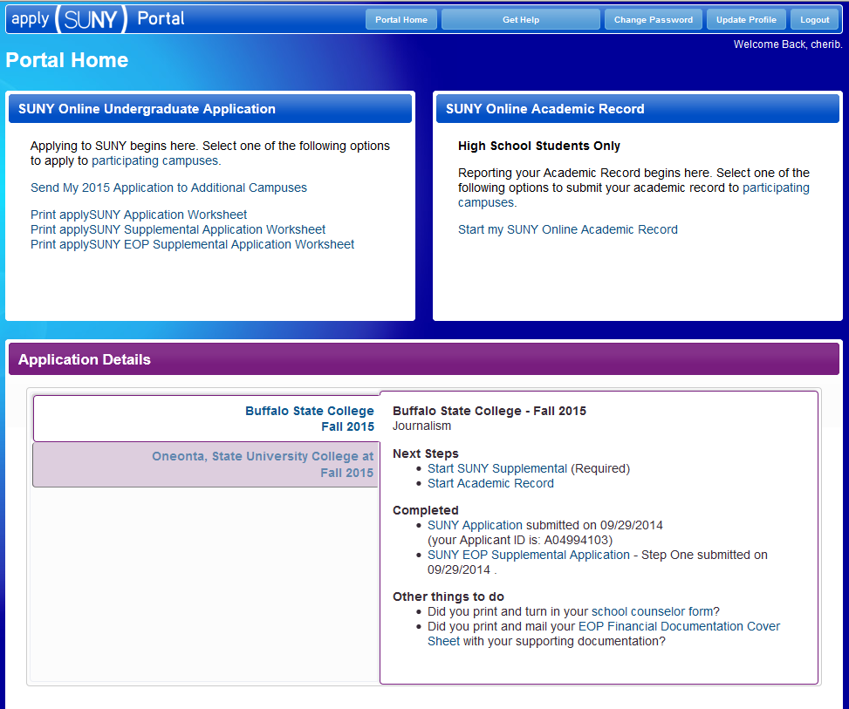

Slide 41
Thank You

